Slide 1

OT = Occupational Therapy
Updated Jan25
Notes:
Introduce yourself
Hey everyone! Today, we're diving into the world of Occupational Therapy (OT) – a career that's all about helping people do what they LOVE.
I hope by the end of our time together today you all have a better idea of what occupational therapy is and how cool of a career it is!

Slide 2
What is
OCCUPATIONAL
THERAPY
ANYWAY?
🤔
Notes:
Does anyone know what occupational therapy is?
Maybe you or someone you know has received OT in the past?
Does anyone want to take a go at guessing?

Slide 3
😍
What are
some of your
favorite things
to do?
💃🏽
📷
🪴
🏈
👟
🎨
🎮
🍔
Notes:
Let's start by talking about some of your favorite things to do.
Think about everything you do in a day, from when you wake up until you sleep.
What do you love to do?
(call on a few people - get them talking)
Notes: Ask them about extracurricular activities, clubs, and hobbies. Something like "Maybe you are involved in a student group on or off campus - like intramural sports teams, a dance team, a club, or just like to do something for fun."

Slide 4

Occupations
Things that make life meaningful
Notes:
Those are all occupations.
The things that make your life meaningful.
Occupations also include the things you need to do, not just what you want to - to live life independently.......like getting out of bed, taking care of yourself, shopping, texting, viewing social media, taking care of your pet, watching movies, going to class - everything and anything you do from the time you wake up until you sleep - which is also an occupation by the way!

Slide 5
Imagine if you or the people you love couldn’t do the things they love to do anymore.
😢
😔
🥹
☹️
😭
😞
Notes:
Imagine if you couldn't
do the things you love and need to do every day. Or what if it was your parents or siblings or friends that couldn't?
Think about how you would feel.
Maybe they can't do them because they had an accident, or maybe they have trouble doing things that were once easy to do because they had a bad fall or an illness.
Or maybe you know someone who might need extra help with things.

Slide 6
Occupational Therapy
helps people
do the things they need
and want to do!
Notes:
Occupational therapy - what I do - helps people do the things they need, want to do, and are expected to do.

Slide 7

Support parents with
premature infants
Notes:
We can help parents with premature infants learn how to care for their children, such as feeding techniques and positioning. We can also help parents take care of themselves, including stress management techniques and providing education and resources.

Slide 8

Help people experiencing homelessness learn how to access community resources
Notes:
We can help people experiencing homelessness learn how to access community resources, such as housing, food banks, health care supports, or community organizations based on individual interests and needs.
We also support developing healthy habits and routines, strategies for self-care when resources are limited, being consistent with medication routine, getting basic needs met, stress management, harm reduction if they also have substance use, managing mental health etc.

Slide 9

Support child with autism to
participate in school
Notes:
We help children with autism or other neurodiverse kids or those with disabilities to participate in school and become more independent.
We can help children improve their coloring, cutting, drawing, and handwriting skills. We can also help children manage fasteners, so they can independently take off their jacket in the morning and put it back on in the afternoon. We can also help children self-regulate, so they can screen out distractions during class lessons.

Slide 10
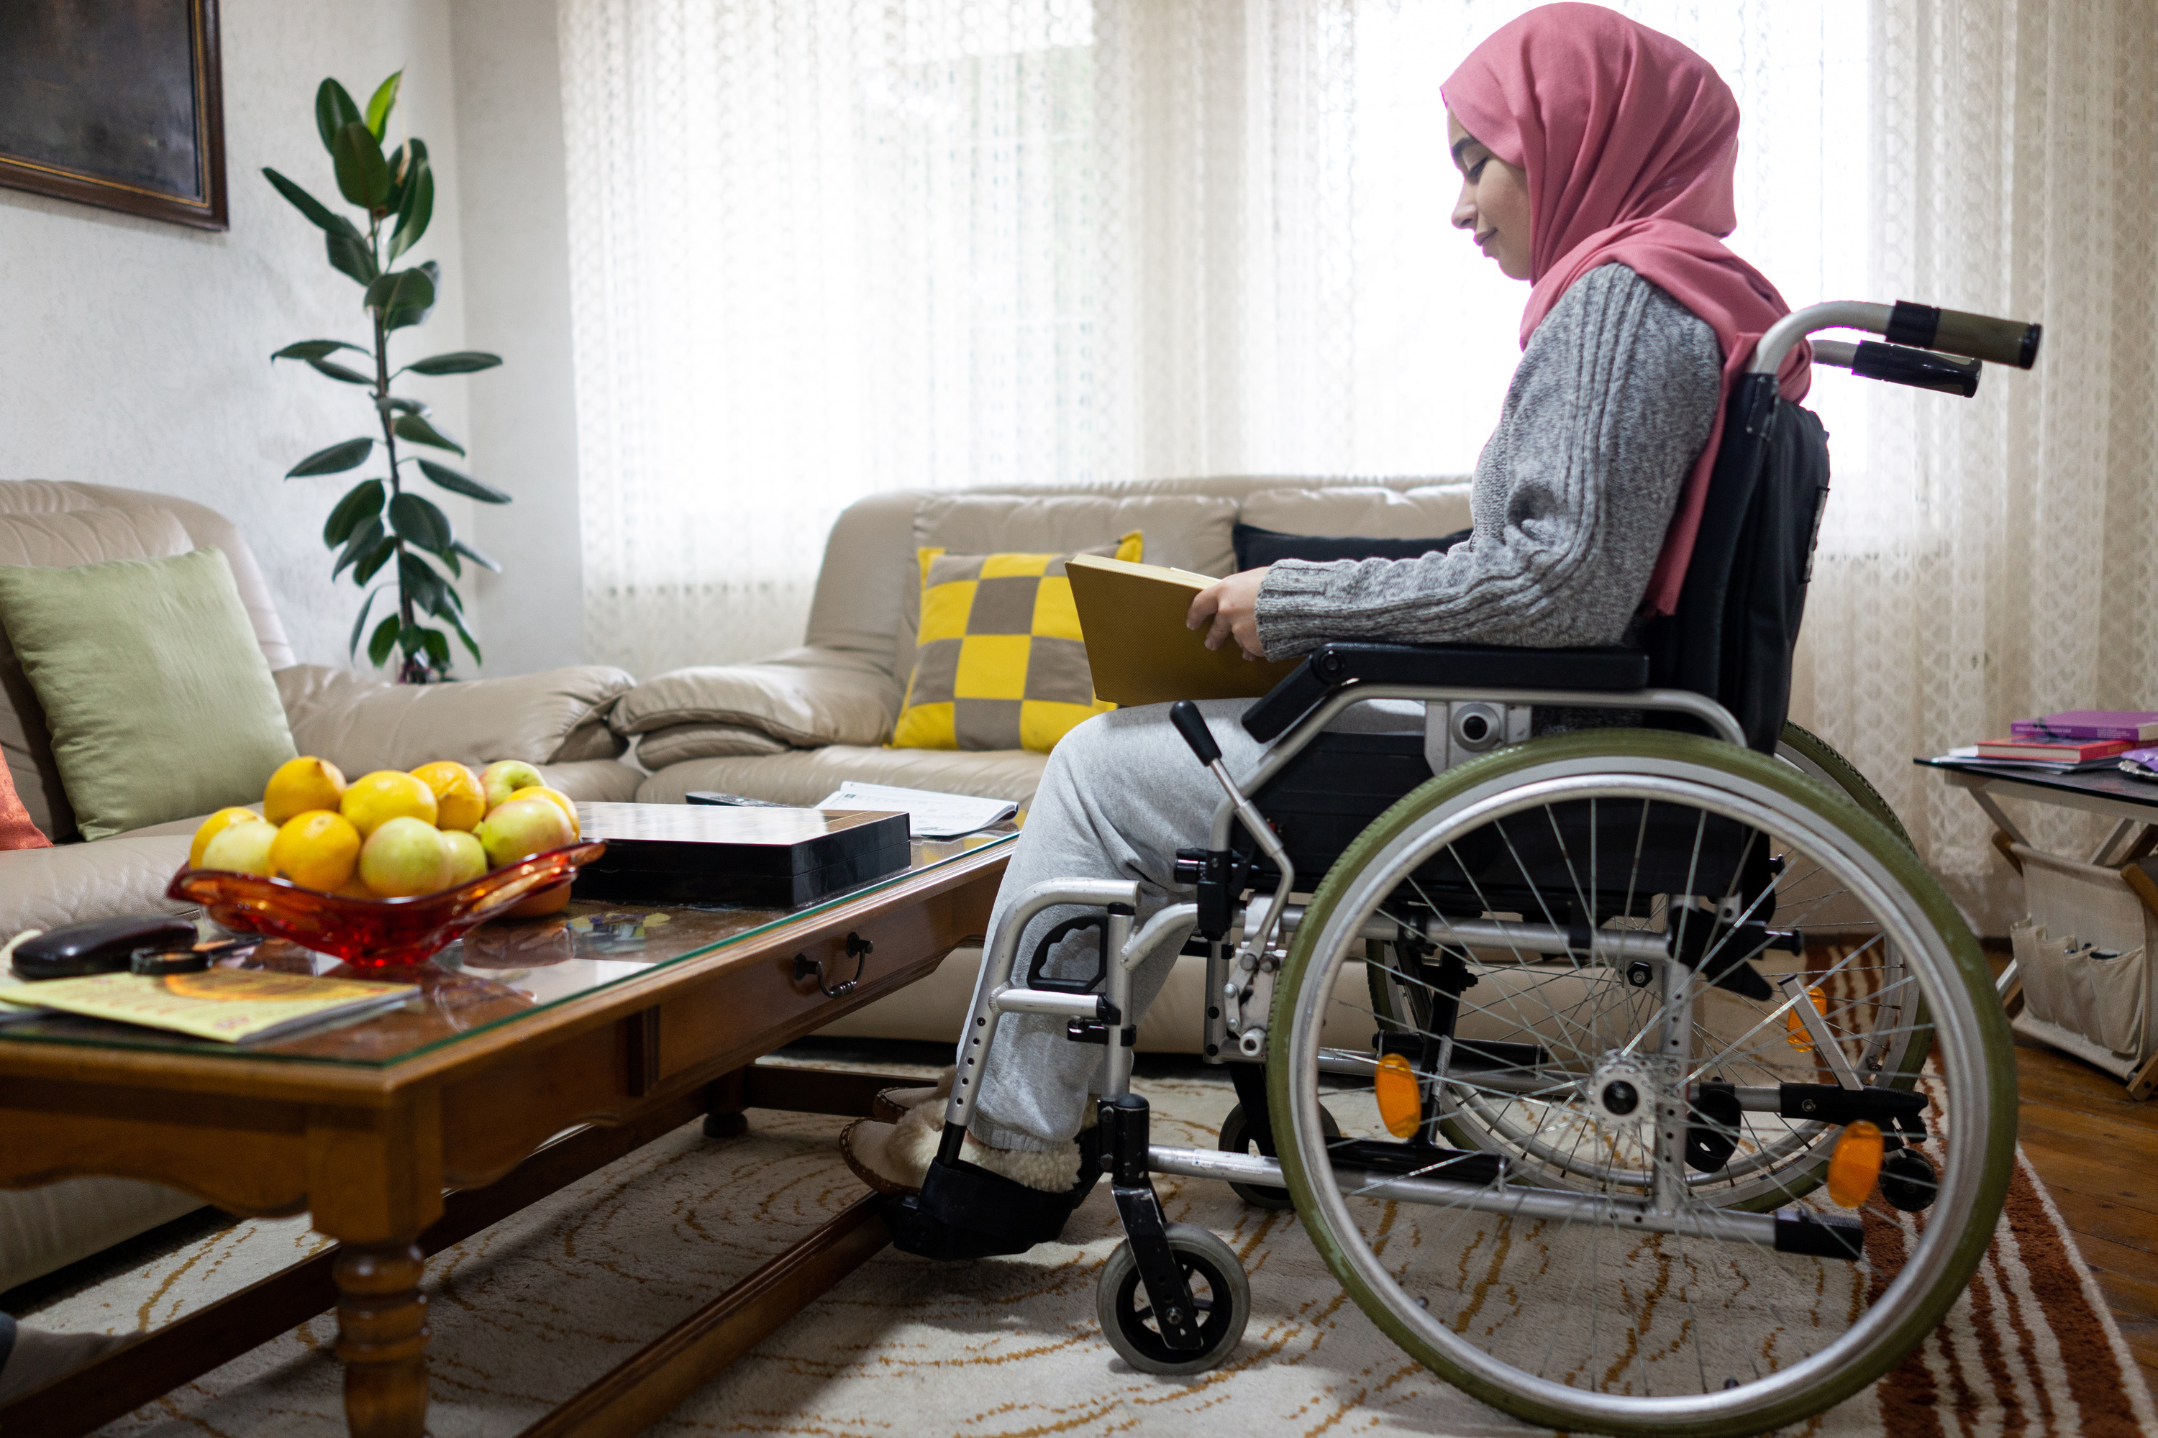
Help someone
using a wheelchair achieve greater independence
Notes:
We can help people using a wheelchair by helping them learn how to transfer on and off of it safely.
We also help with wheelchair selection and customization; to ensure comfort, safety, and optimal mobility.
We recommend modifications like ramps, grab bars, or widened doorways to make these spaces easier and safer to navigate in a wheelchair.
How to dress, bathe, and get ready for their day.
We can help with power wheelchairs, using special controls for people who can't use their hands to steer, and voice tools for people who can't speak.
We help them live a full and independent life!

Slide 11

Substance use recovery
Notes:
We can help various individuals rebuild life skills - such as self-care, coping skills, establishing healthy routines, and time and money management. Maybe these individuals are recovering from addiction, were recently released from incarceration, or are learning how to care for their mental health.

Slide 12
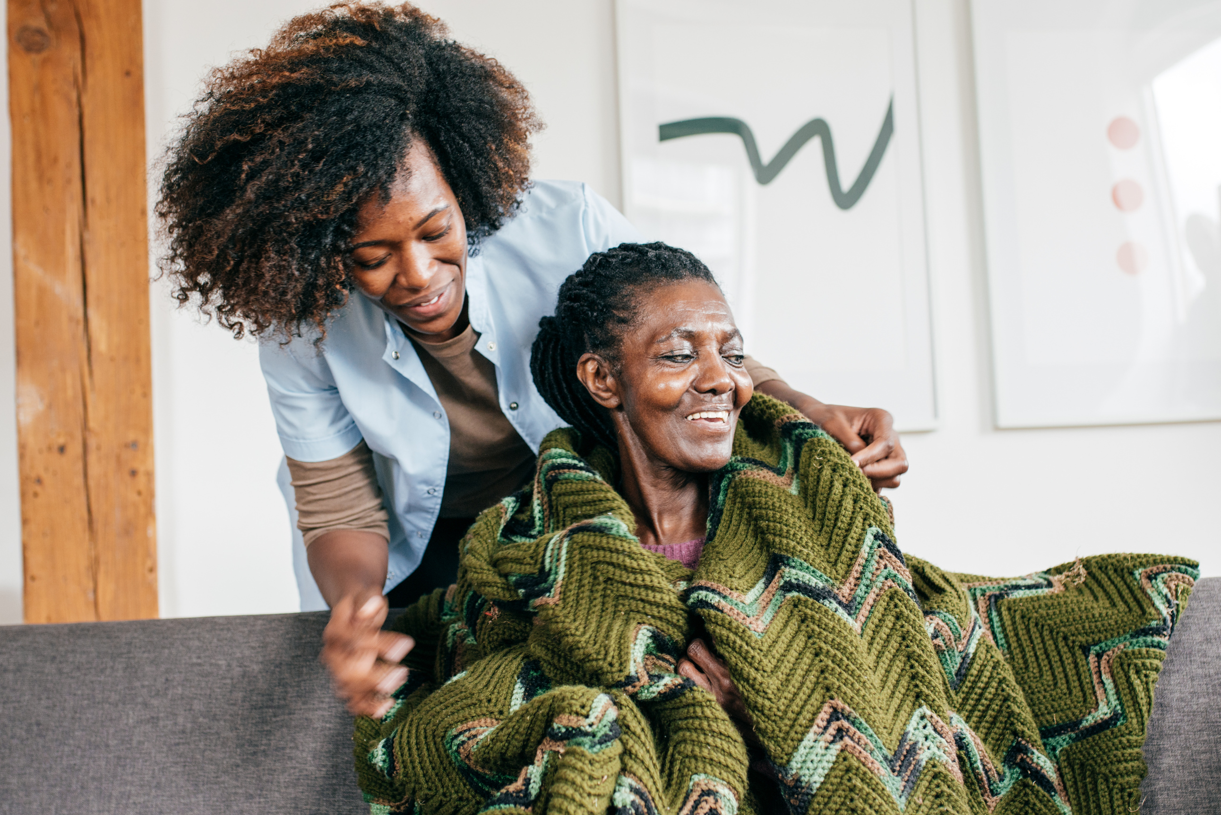
Help older adults
age in place
Notes:
We empower seniors to age safely and comfortably at home. We assess living spaces for safety hazards, recommend modifications like grab bars or ramps, and teach strategies for daily tasks like bathing and dressing, even providing adaptive equipment for this as necessary.
We assess routines to ensure they are safe like meal prep and using the stove, doing laundry in the basement, and filling a pillbox accurately. etc.
We empower older adults to prevent falls by improving their strength, balance, and home safety awareness.
OT addresses physical and cognitive skills to support individuals to age in place.

Slide 13

Notes:
We can work with individuals across the lifespan - meaning we can work with babies to individuals at the end of life.
And you don't need additional schooling or specializations to do it!

Slide 14
Occupational Therapy is
HOLISTIC
🤷🏽
What does that even mean?....
Notes:
Occupational therapy is Holistic.
Does anyone know what I mean by that?

Slide 15
Cognitive
Occupations
Sensory
Physical
Environment
Emotional
Social
Notes:
The focus on the whole person and their daily life is what makes occupational therapy a holistic approach to healthcare.
We consider the whole person - not just their medical condition.
Their occupations, physical, emotional, social, sensory, and cognitive needs.
We assess their environments - Their home, work, and community
This allows us to provide a client-centered therapy plan that will improve the individual's quality of life and overall well-being.

Slide 16

Cognitive
Environment
Memory
Modify
Attention
Adapt
Sensory
Social
Retrain
Connections
Physical
Emotional
Strengthen
Safe space
Notes:
Imagine a person who has a stroke. Physically, they might have weakness on one side of their body, making activities like bathing or dressing challenging. Cognitively, they might struggle with memory and attention, leading to difficulty planning and completing tasks. Their sensory needs may be to retrain the brain to interpret sensory signals correctly. Socially, they might feel isolated due to difficulty leaving the house, which could trigger feelings of anxiety or depression. Emotionally the OTP creates a safe space for the person to express their emotions and develop coping mechanisms for anxiety or depression.
The OTP might recommend modification to the home or adaptive equipment to improve independence

Slide 17
A doctor will help save your life.
An occupational therapy practitioner will help you live it!
Notes:
It's often said that a doctor will save your life, but an occupational therapy practitioner will help you live it!
It isn't much of a life if you can't do the things you need and want to do! Right?

Slide 18

Help people live their
BEST LIVES!
Notes:
We help people participate in meaningful activities that allows them to live their best life!

Slide 19
Occupational therapy
is in many
different places.
Notes:
Occupational therapy can be found in many different places or settings.

Slide 20

Hospitals
Notes:
We can work in hospitals. Helping people who have been sick or hurt get back to doing what they want and need to do.

Slide 21
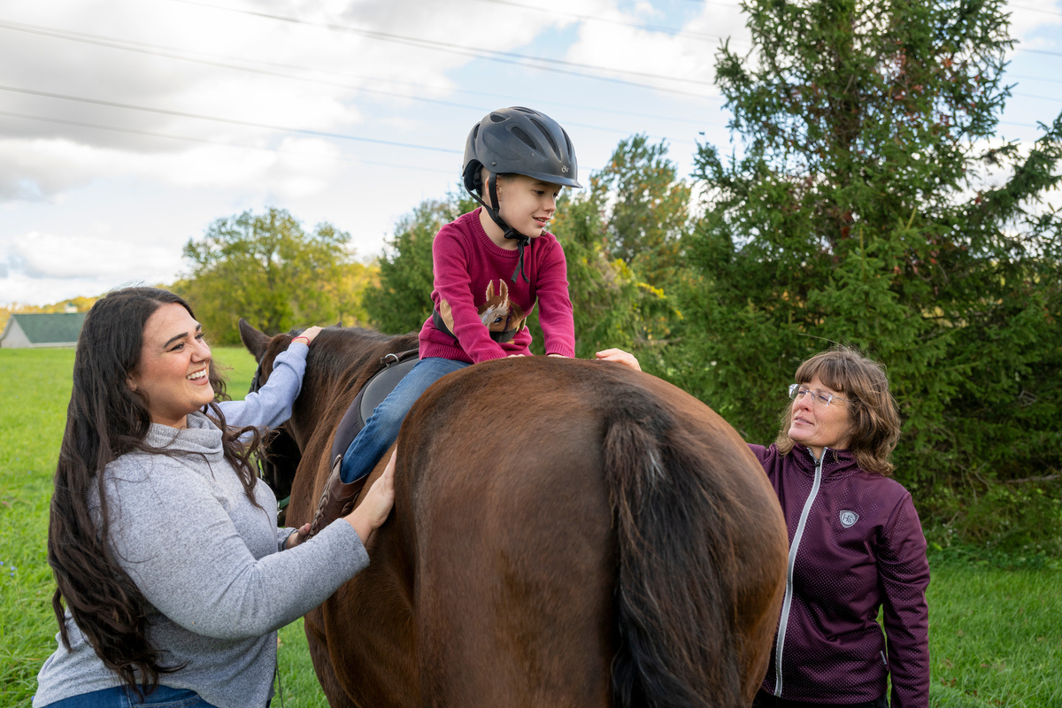
Horse Farms
Notes:
We can work on horse farms.
The horse's movements help with things like balance, strength, and coordination.
This area of practice is called hippotherapy.

Slide 22

Schools
Notes:
We can work at schools too. - making sure everyone is the best they can be!
Maybe there was an OT or OTA at your school when you were younger

Slide 23

Nursing
Homes
Notes:
We can work in nursing homes. We can help older adults, or maybe even your grandparents do fun activities and stay strong so they can keep doing the things they love, like playing games and taking care of themselves.

Slide 24

Military
Notes:
You can become an occupational therapy practitioner while being in the military. You can also work with military personnel and veterans.

Slide 25

Home Health
Notes:
You can work in home health by visiting people's homes and helping them improve their ability to do daily activities. We assess the home environment and suggest changes to make it safer and easier to navigate. OTPs teach new skills and provide strategies to help people reach their personal goals, such as bathing, medication management, or cooking. We also support family members and caregivers with advice and guidance.

Slide 26
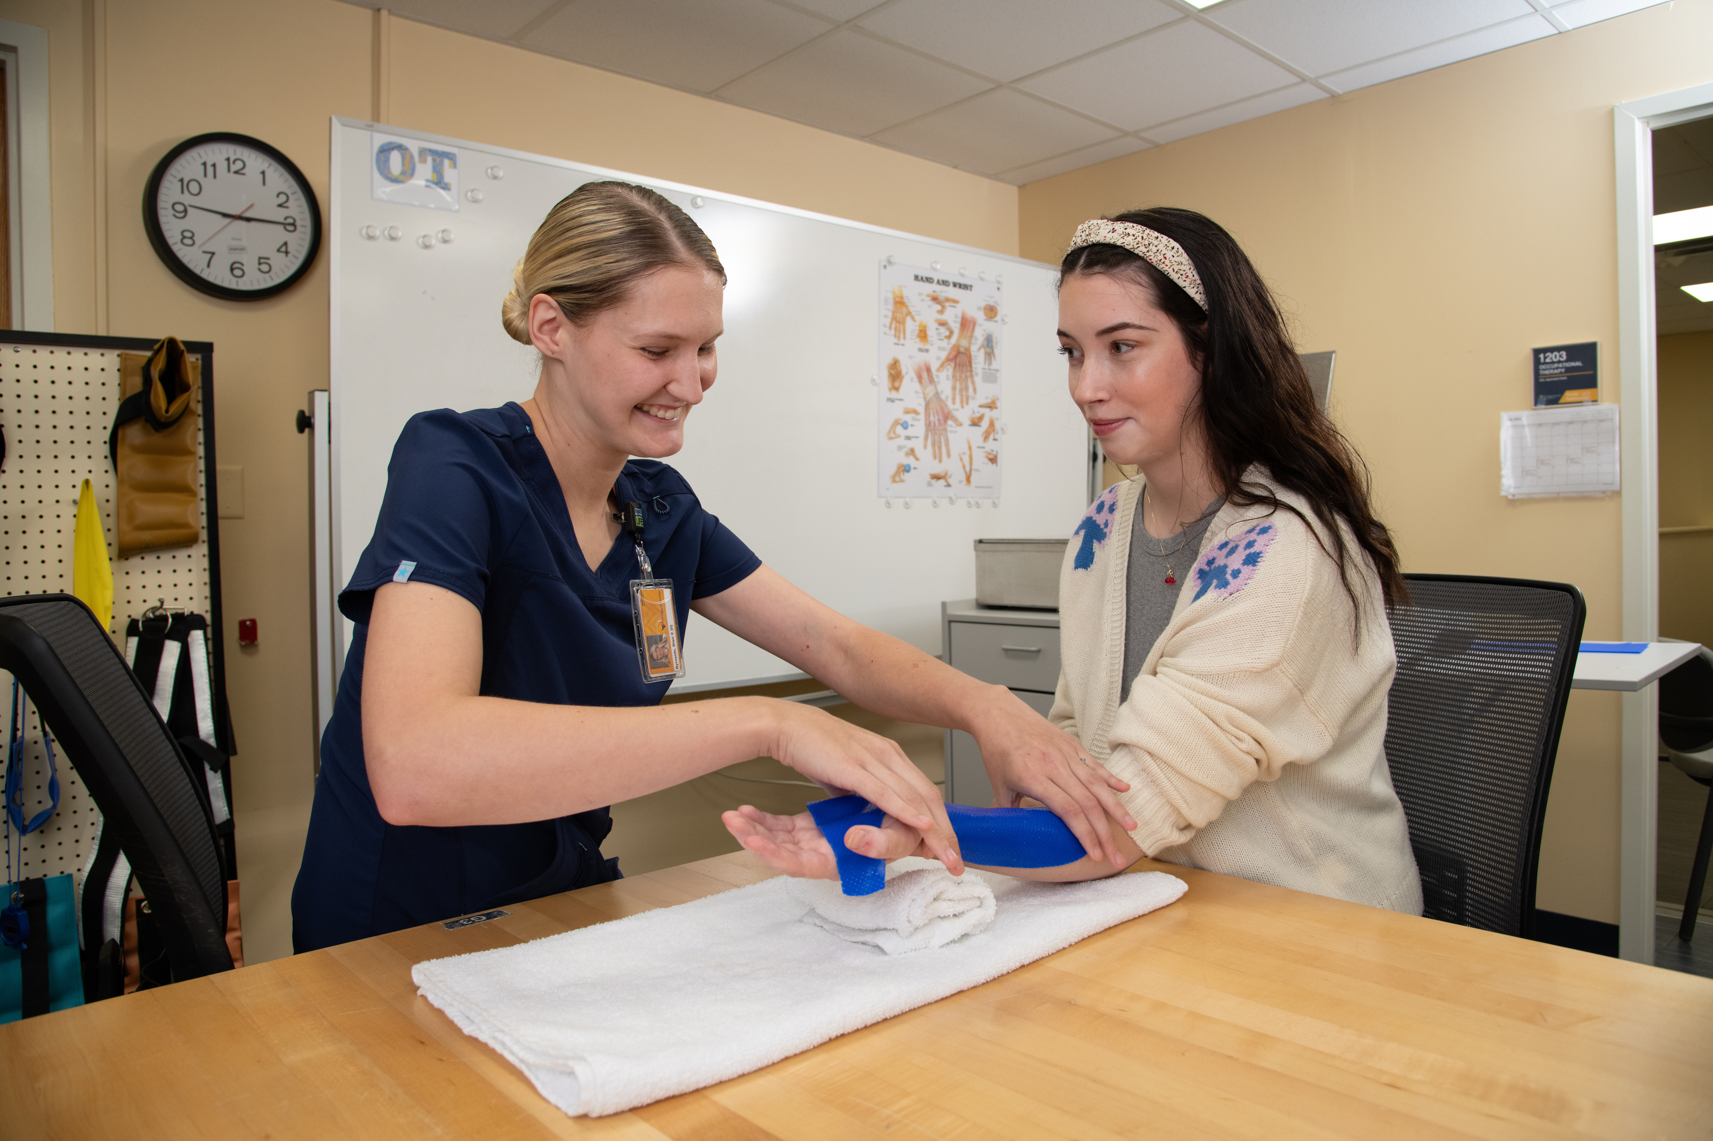
Outpatient Settings
Notes:
We can provide one-on-one, personalized care in an outpatient setting, which could be a healthcare facility or private clinic.
Helping clients to address their specific needs and goals, which might include improving physical mobility, enhancing cognitive function, or adapting to changes in daily life due to injury or illness.

Slide 27

Community
Notes:
We can also work with people in community-based settings or their natural environment. This might be a community garden, vocational programs, adult or child day care, or parks.

Slide 28

Nature Therapy
Notes:
We can work outside in nature.
By using nature to improve participation in meaningful activities like hiking or gardening. This OT expertise, combined with the calming power of nature, fosters holistic well-being for people of all abilities.

Slide 29

Telehealth Remote Work
Notes:
OTPs can use telehealth to provide services to people in rural areas or who have difficulty traveling. This can be a great way to reach a wider range of clients and make occupational therapy services more accessible.

Slide 30

Travel Therapy
Notes:
OTPs can work for companies that allow them to travel around the United States while working in various settings. Contracts are typically 13 weeks at a time but can vary. Some companies may assist with state license and relocation costs.
It's a great way to see the country while getting paid to do it!

Slide 31

Driving Rehabilitation Centers
Notes:
Occupational therapy professionals can help people who have had a stroke, brain injury, or other medical condition to learn how to drive again. This can be a life-changing service for people who rely on driving for work or independence.

Slide 32
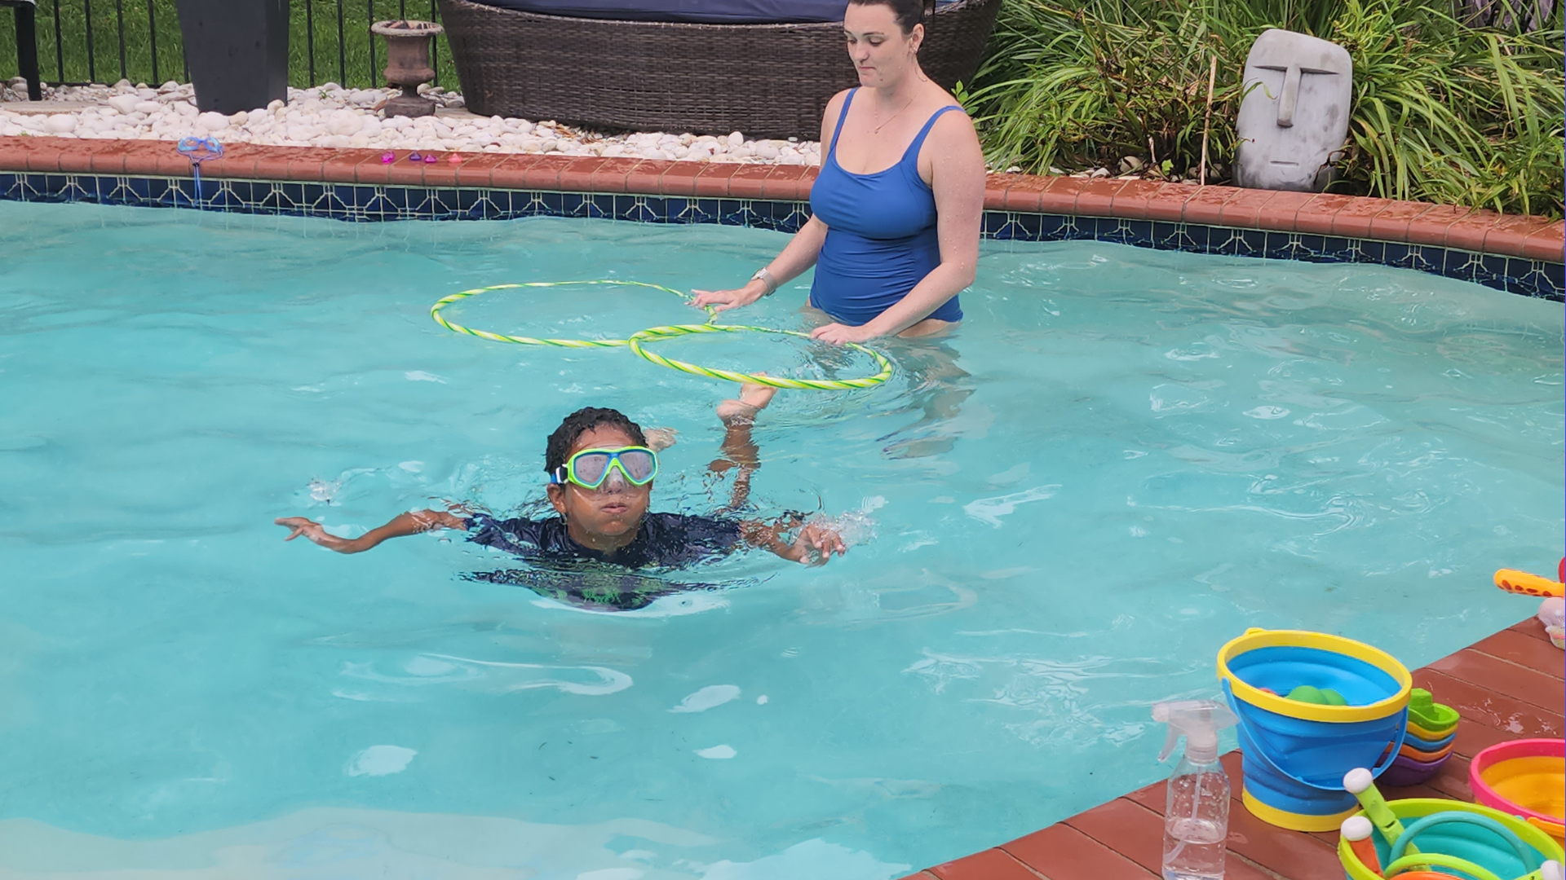
Aquatic
Therapy

Slide 33

Sensory Gyms

Slide 34
Mental Health
Neonatal Intensive Care (NICU)
Palliative Care
Pelvic Health
Primary Care
Rehab Clinics
Researcher
Skilled Nursing Facilities
Vision
Academia
Acute Care
Adult Day Programs
Animal-Assisted Therapy
Assistive Technology/Gaming
Assisted Living Facilities
Aquatic Therapy
Cardiac Rehab
Correctional Facilities
Ergonomics
Intensive Care Unit (ICU)
Notes:
Here's even more settings where you can find OT practitioners
As you can see, OT is an very versatile profession!

Slide 35
Occupational Therapy
Practitioners can be:
clinical practitioners
researchers
professors
advocates
entrepreneurs
CEOs
influencers
Notes:
You can be a clinical practitioner, a researcher, a professor, an advocate an entrepreneur, a CEO, an influencer

Slide 36
And so much more!
Where there are people, there is a need for occupational therapy
Notes:
And so much more! Where they are people, there is a need for occupational therapy!

Slide 37
Qualities of an Occupational Therapy Practitioner
👍🏽
Notes:
You might be thinking, what type of person is best suited to be an occupational therapy practitioner.
Here's some qualities that are good to have when working in OT

Slide 38
People Person
Creative Problem Solver
Communication
Patience
Notes:
You have to like people to get into occupational therapy. That's the whole point of our job - to help people live their best lives!
We work with clients in one-on-one or small groups
You'll need
Empathy and compassion: Understanding and acknowledging the challenges clients face and showing genuine care for their well-being.
The ability to analyze situations, identify challenges, and develop creative solutions to help clients achieve their goals.
Excellent communication skills: The ability to clearly explain diagnoses, treatment plans, and recommendations to clients and their families in an understandable way.
and
Active listening skills: Giving clients a safe space to express their needs, concerns, and goals.
Patience and positive attitude: Recovery can take time, and a good OTP needs to be patient and supportive throughout the process.

Slide 39
Adaptability/Flexibility
Collaboration
Learner
Cultural Humility
Notes:
Adaptability and flexibility: Being able to adjust treatment plans and approaches as needed to meet the unique needs of each client - this goes back to what we talked about with holistic care - and what makes OT so unique, since we look at what matters to the client.
Teamwork and collaboration: Working effectively with other healthcare professionals, families, and caregivers to ensure coordinated care.
Lifelong learning: The field of OT is constantly evolving, and a good OT is committed to ongoing learning and professional development.
Cultural humility: Understanding and respecting diverse cultural backgrounds and beliefs to provide culturally sensitive care.

Slide 40
What is an Occupational Therapist (OT)?
Notes:
What's an occupational therapist or an OT for short?

Slide 41

An occupational therapist (OT) will assess and design interventions to enhance independence
Notes:
An OT assesses and designs interventions to enhance independence and overall well-being.

Slide 42
What is an Occupational Therapy
Assistant (OTA)?
Notes:
So what's an OTA then?

Slide 43
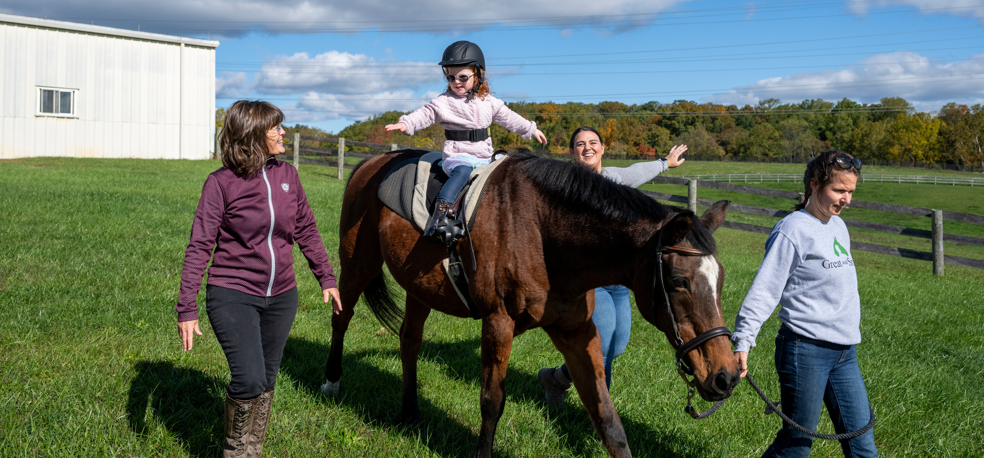
An occupational therapy assistant (OTA) works under the supervision of an occupational therapist (OT) to implement those interventions.
Notes:
An OTA works under the supervision of the OT to implement those interventions.
An occupational therapy assistant (OTA) requires an associate’s or bachelor’s degree for this role.

Slide 44
Pathway to Becoming an Occupational Therapist
1
Complete an undergrad degree.
Explore and apply to an accredited Master of Occupational Therapy (MOT) or Doctor of Occupational Therapy (OTD) program.
Graduate with a MOT or OTD degree.
Pass the national occupational therapy board exam and earn OTR® certification.
Obtain a state license to practice.
2
3
4
5
Notes:
To become an occupational therapist, you'll need to start with an undergrad degree. Then you can explore OT grad degrees. You can get either a Master's or Doctorate.
Once you graduate you will need to take and pass the national board exam which allows you to obtain a state license to practice.

Slide 45
Popular Undergraduate Majors
Kinesiology
Biology
Psychology
Exercise physiology
Chemistry
Health sciences
Education
Sociology
Therapeutic recreation
Non-traditional majors
(e.g. Art & Theater)
Notes:
You don't need an undergrad in OT - it can be in any field you want. You just need to have the prerequisites required to get into OT school.
Some people do their undergrad in health sciences, or Kinesiology, and some in art, theater, and music.

Slide 46
How To Prepare
Notes:
So if you are interested, how can you prepare for a future in occupational therapy now?

Slide 47
Talk to or interview occupational therapy practitioners
Notes:
Find out more by talking to or interviewing occupational therapy practitioners.
You can find them by reaching out to advisors at schools with OT programs, asking your advisors in your current school/program, reaching out to state OT associations, or finding settings in your area that you can reach out to.

Slide 48

Notes:
Volunteer in settings where occupational therapy services are provided so you can witness it and be a part of it.
Remember all of those different settings we talked about earlier?
Seek out places where you can observe it happening.

Slide 49

Observation Hours
Notes:
Schools require a specific amount of observation hours for their applications - 50 hours is the average - with some schools lower and some higher.
Keep a log of where and what you observed and consider getting something in writing from the OT you observed.

Slide 50
Research Schools
Notes:
It's important to explore and research OT schools throughout the US.
Each school has its specific requirements and prerequisite courses.
Our website has info to help you get started.

Slide 51
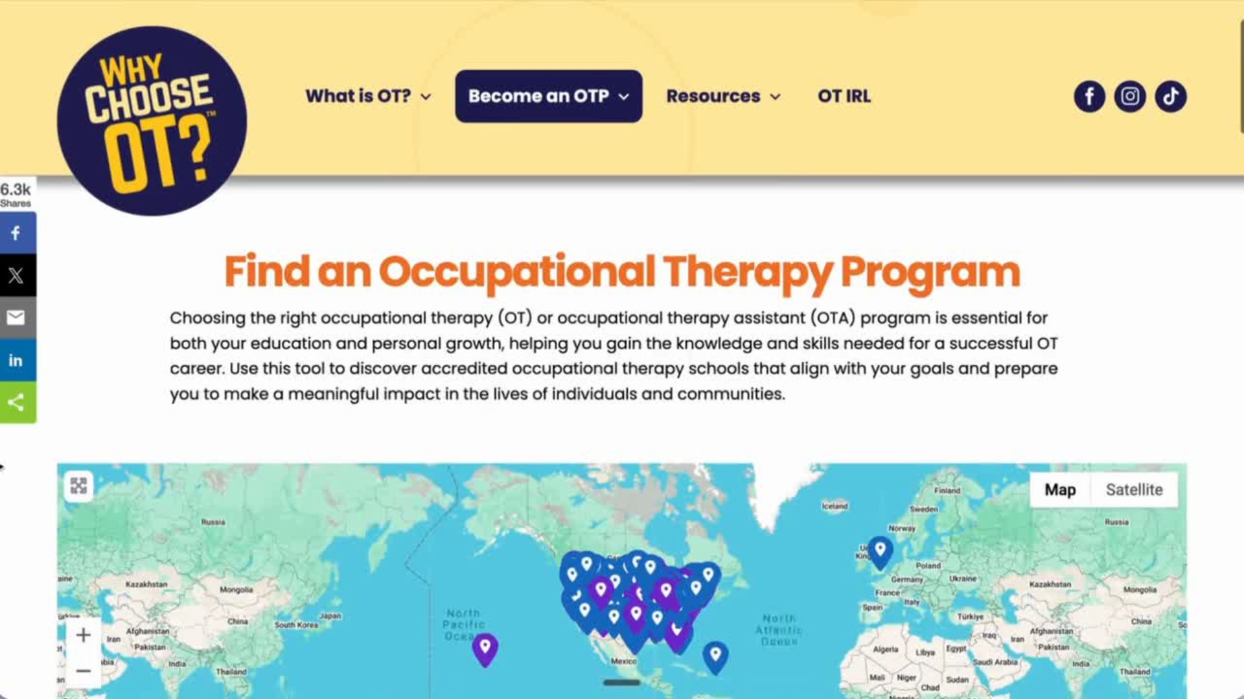
Notes:
You can view all of the schools offering OT and OTA programs the program directory found at whychooseot.com.
You can search via the map or by state.
Each school listing contains links to all of their social media accounts, so you can see what it is like at that specific school.

Slide 52
Take Prerequisite Courses
Anatomy and physiology
Physics
Statistics
Developmental psychology
Biology
Psychopathology
Sociology/Anthropology
Kinesiology
Medical Terminology
Notes:
Common prerequisite courses can include:
Anatomy and physiology
Physics
Statistics
Development psychology
Biology
Psychopathology
Sociology/anthropology
Kinesiology
Medical Terminology
But again it is always important to check the school's website where you wish to apply to confirm.

Slide 53
Letters of Recommendations
Professors
Bosses/Supervisors
OT practitioners
Coworkers
Professionals
Family
Friends
High school teachers
Notes:
You'll need letters of recommendation. You should look at professors, bosses, supervisors, OT practitioners whom you observed with, coworkers, or other professionals who know you well through volunteer, work, or school activities.
Do not get your letters from family, friends, or high school teachers.
Some schools require two letters, some require three.

Slide 54

Personal Statement / Essay
Notes:
You'll need to write a personal statement or essay, explaining why you have selected occupational therapy as a career and how this degree relates to your immediate and long-term professional goals.
You can share how lived experiences - personal, professional, cultural, or other have influenced your interest in pursuing OT.
This is truly your opportunity to stand out from other applicants - by highlighting your uniqueness and how you will positively contribute to the program and ultimately the profession.
Again always check what the school requirements are. Some ask that you answer additional questions.

Slide 55
Personal Statement / Essay
Take time and prepare
Be creative
Proofread
Why you’ll make a good OT
Tie it all together
Be generic
Be cliche
Plagiarize
Use AI
Grammatical errors
Spelling errors
Notes:
It's important to take time to prepare your statement. Give yourself enough time to write and revise well before the deadline
Be creative.
Proofread and have other people do it for you as well
Explain why you'll make a good OT.
Be sure to tie the whole thing together.
Don't be generic, use cliches, plagiarize, use AI, and submit something with grammatical and spelling errors.

Slide 56
Notes:
You'll submit all the required info and documents to the programs you want to apply to through OTCAS - which is the centralized application service for OT programs.
The application cycle opens in July and runs through the following year.
It's important to review the dates on both OTCAS sites and the programs you wish to apply to - as those may differ in terms of deadlines.

Slide 57

School
Interview
Notes:
Some schools require interviews. If the program or programs you are interested in require one, be sure to
- research them
- understand their values
- come prepared with your questions - you are interviewing them as much as they are interviewing you!
Be sure to follow up with a thank you email afterward.

Slide 58
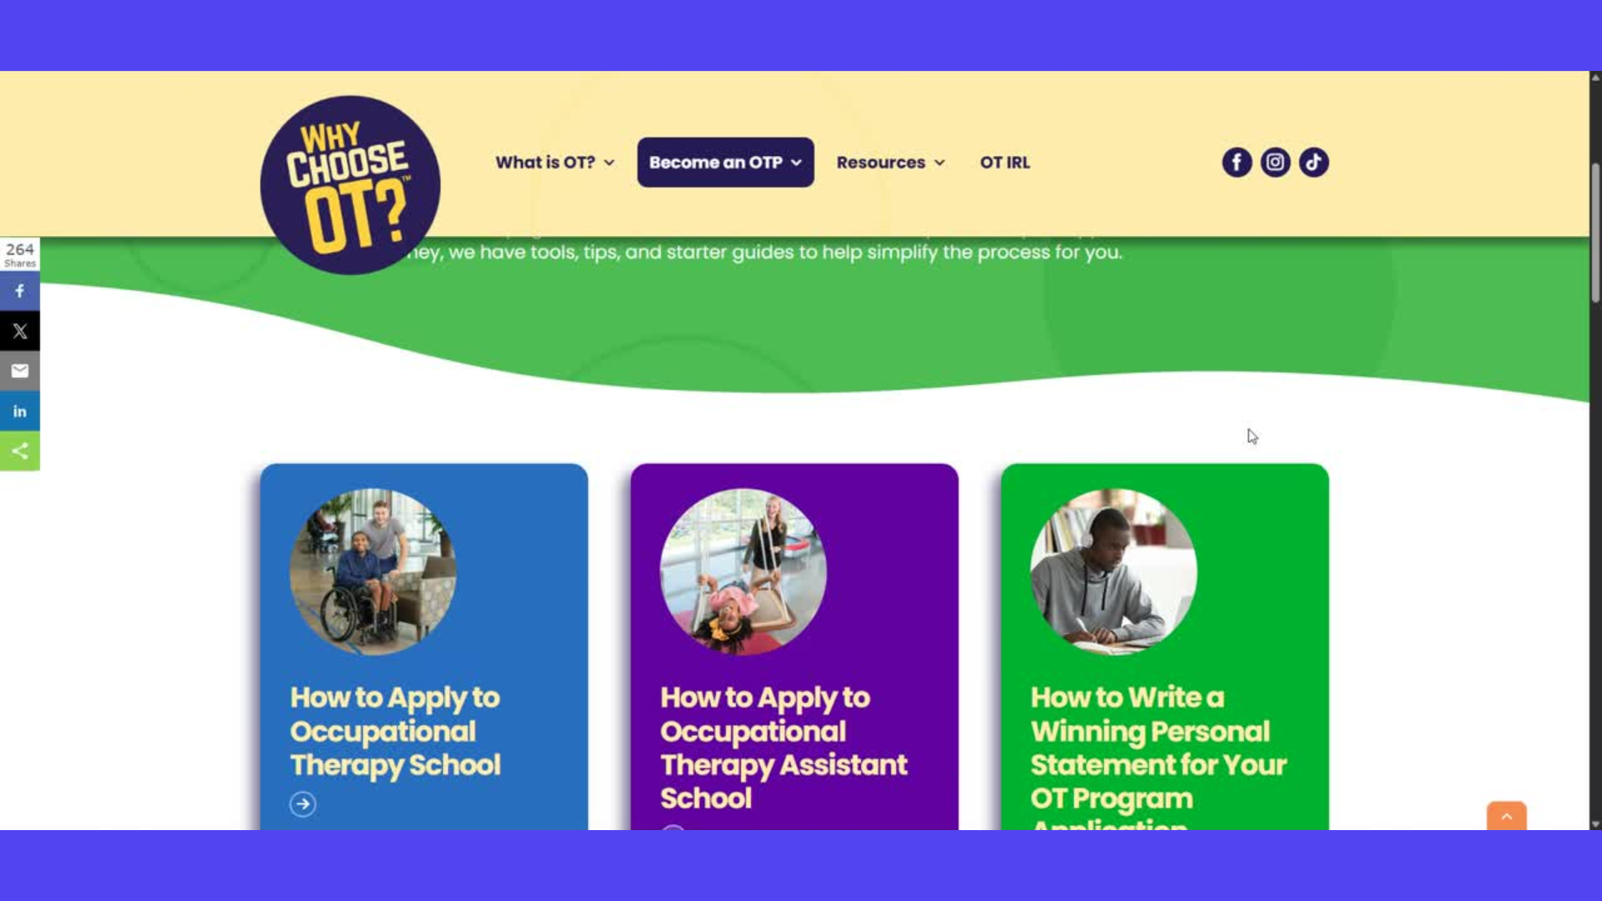

Slide 59
OT Employment Expected to Grow
15%
20%
OT by 2035
OT by 2035
Notes:
The US Bureau of labor and statistics reports that employment in OT is expected to grow by 15% for OTs and 20% for OTAs by 2035.
This is a great indicator of job stability

Slide 60
Financially Rewarding Career
$100,300
$72,300
OT Median Salary
OTA Median Salary
Notes:
Also from the US Bureau of Labor in Statistics :
In 2026, the median salary for an OT was just over 100K, and for an OTA over 72K.
it can vary a bit by location (e.g., city or state).

Slide 61
Meaningful Client Relationships
Rewarding Work
Work-Life Balance
Constantly Evolving Field
Diverse Settings
Every Day is Different
Notes:
Working in occupational therapy provides:
Meaningful client relationships, that results in rewarding work.
You get a great work-life balance, by choosing where and how you want to work.
The field is constantly evolving and you get to work in so many different settings.
Every day is different and allows you the opportunity to make a positive impact on someone's life.

Slide 62
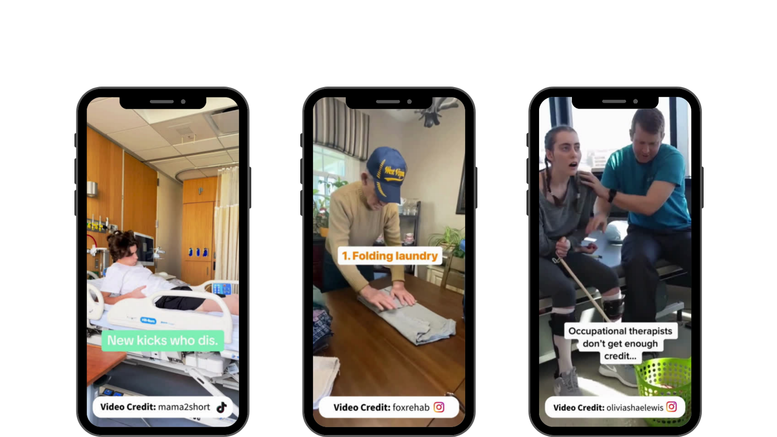
Change Lives
Notes:
Here's just a few examples of OT.
Helping a teenager reclaim his independence after a spinal cord injury
Helping individuals with dementia live as independently as possible.
Helping someone who has suffered a traumatic brain injury learn how to do everything again.

Slide 63
Make a difference in someone’s life everyday!
🤗
Notes:
Occupational therapy practitioners make a difference in someone's life everyday!

Slide 64
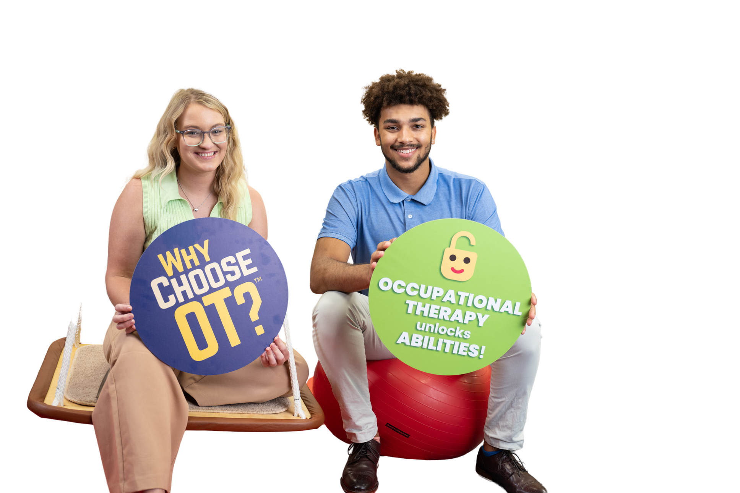
Stay Connected
@WhyChooseOT
Notes:
Stay connected. Learn more about occupational therapy and OT in action by following WhyChooseOT on TikTok and Instagram.

Slide 65
WhyChooseOT.com
Notes:
You can find the info we talked about today and more at whychooseot.com
Does anyone have any questions about what we talked about?
Thank you for letting me spend time with you today.

