Slide 1
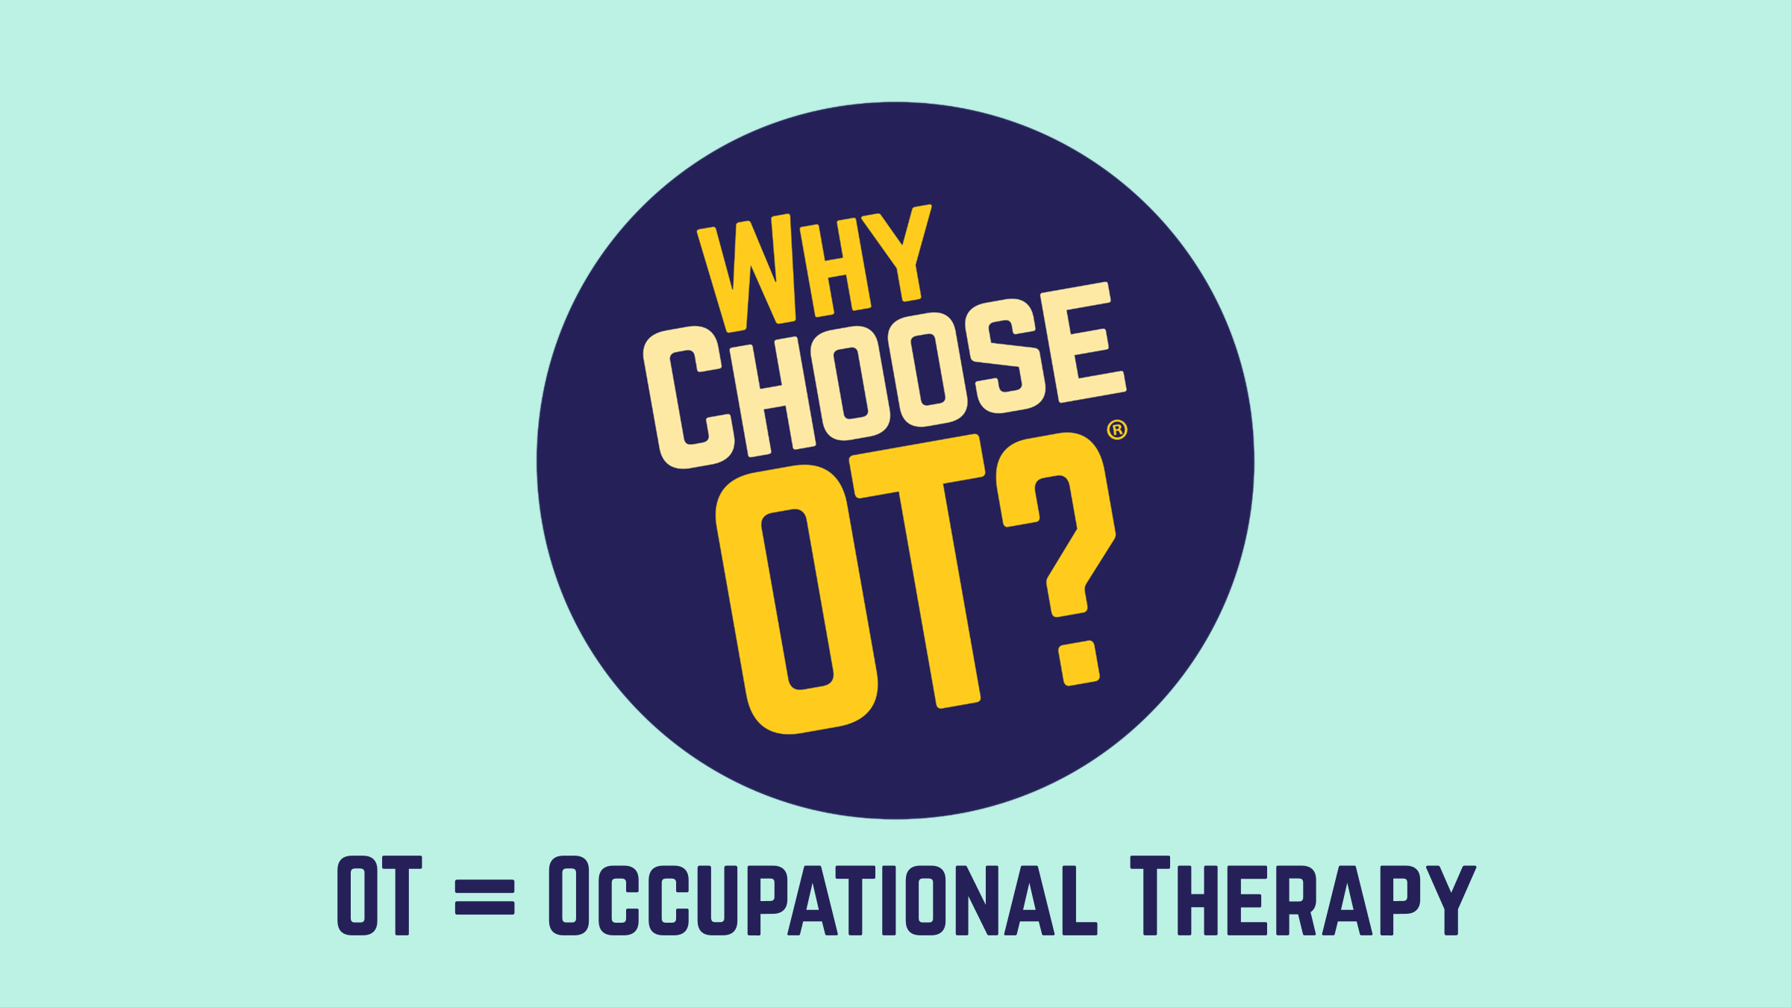

OT = Occupational Therapy
Notes:
Introduce yourself
Hey everyone! Today, we're diving into the world of Occupational Therapy (OT) – a career that's all about helping people do what they LOVE.
I hope by the end of our time together today you all have a better idea of what occupational therapy is and how cool of a job it is!

Slide 2
What is
OCCUPATIONAL
THERAPY
ANYWAY?
🤔
Notes:
Does anyone know what occupational therapy is?
Maybe you or someone you know has received OT in the past?
Does anyone want to take a go at guessing?

Slide 3
What are
some of your
favorite things
to do?
😍
💃🏽
📷
🪴
🏈
👟
🎨
🎮
🍔
Notes:
Let's start by talking about some of your favorite things to do.
Think about everything you do in a day from the time you wake up until you sleep.
What do you love to do?
(call on a few kids - get them talking)
Notes: Get them to think about extracurricular activities, clubs, and hobbies. Something along the lines of "Maybe after school you're part of a sports team, or club, or like to do something for fun."

Slide 4

Occupations
Things that make life meaningful
Notes:
Those are all occupations.
The things that make your life meaningful.
Occupations also include the things you need to do, not just what you want to - to live life independently. These are called activities of daily living......like getting out of bed, taking care of yourself, shopping, texting, viewing social media, taking care of your pet - everything and anything you do from the time you wake up until you sleep - which is also an occupation by the way!

Slide 5
Imagine if you or the people you love couldn’t do the things they love to do anymore.
😢
😔
🥹
☹️
😭
😞
Notes:
Imagine if you couldn't
do the things you love and need to do every day. Or what if it was your parents or siblings or friends that couldn't?
Think about how you would feel.
Maybe they can't do them because they had an accident, or maybe they have trouble doing things that were once easy to do because they had a bad fall or an illness.
Or maybe you know someone who might need extra help with things.

Slide 6
Occupational Therapy
helps people
do the things they need
and want to do!
Notes:
Occupational therapy - what I do - helps people do the things they need and want to do.

Slide 7
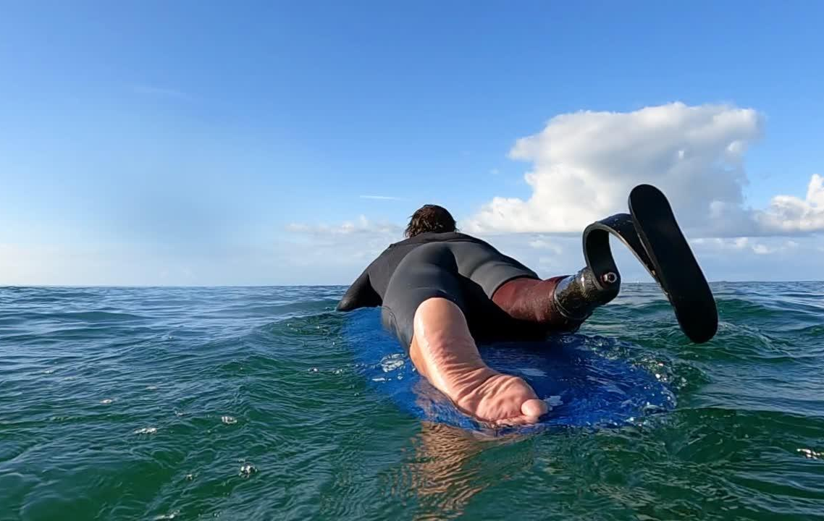
Help someone get back
to surfing
Notes:
We can help someone get back to surfing after they have had an injury.

Slide 8

Help someone
with handwriting
Notes:
We can help people with handwriting - to learn how to grasp a pencil properly, to form and space out letters

Slide 9

Help someone
get back to work
Notes:
We can help someone get back to work after struggling with a period of depression.

Slide 10
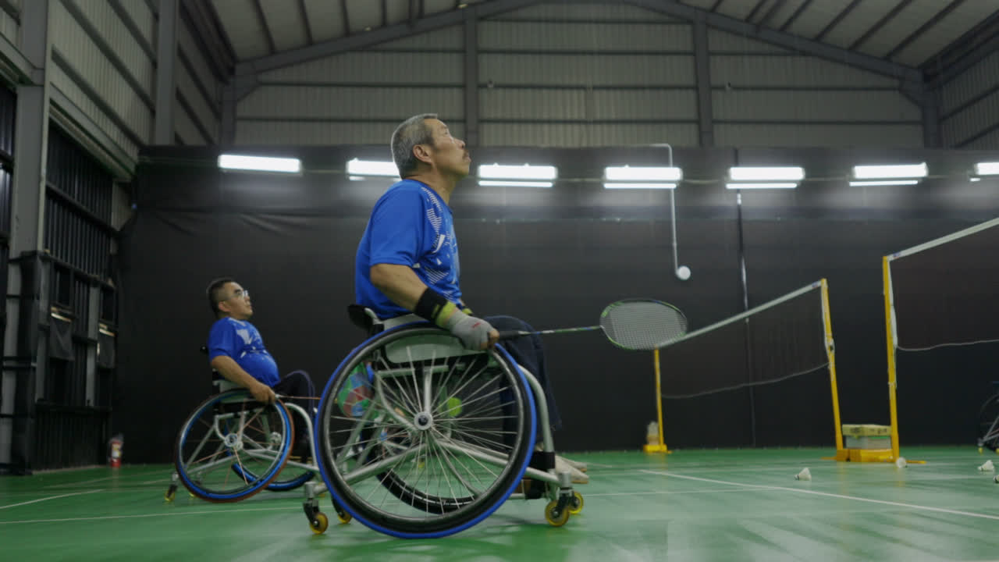
Help someone
using a wheelchair live their life
Notes:
We can help people using a wheelchair by helping them learn how to get in and out of it safely.
How to make their home more accessible for their wheelchair.
How to dress, bathe, and get ready for their day.
We can help with power wheelchairs, using special controls for people who can't use their hands to steer, and voice tools for people who can't speak.
We help them live a full and independent life!

Slide 11
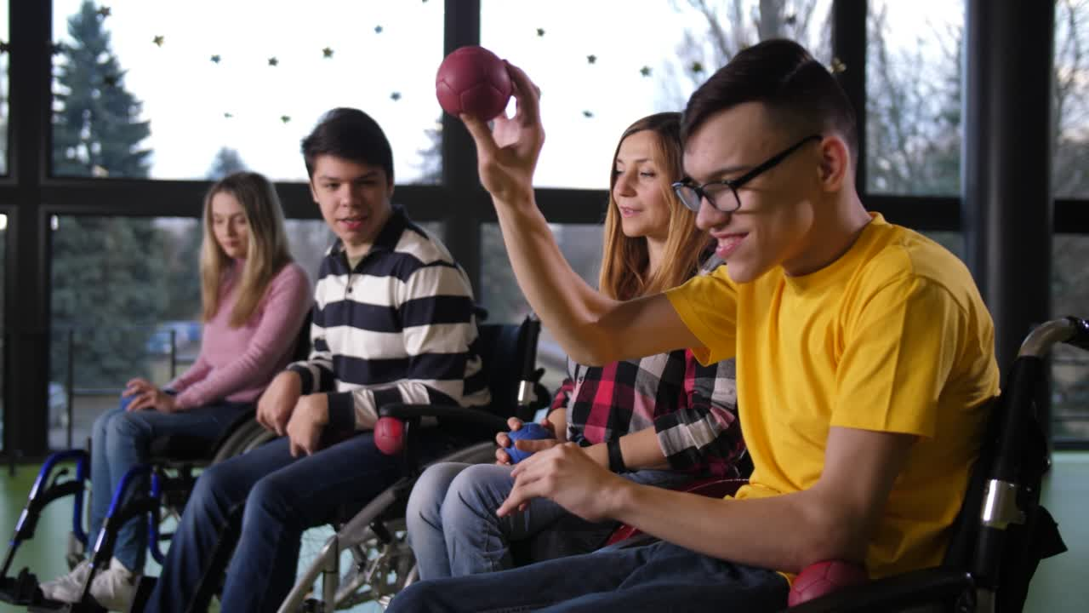
Help someone play
Notes:
We can help kids and adults play or engage in leisure activities.
Play isn't just about fun and games; it's a powerful tool to help achieve specific therapeutic goals.
A child with fine motor challenges might play with Play-Doh to improve hand strength and dexterity.
An adult might enjoy gardening and can plant small seeds and trim/prune plants to work on fine motor skills and grip strength
An autistic person might engage in social skills games to learn turn-taking and communication skills.

Slide 12
Occupational Therapy is
HOLISTIC
🤷🏽
What does that even mean?....
Notes:
Occupational therapy is Holistic.
Does anyone know what I mean by that?

Slide 13
Cognitive
Occupations
Sensory
Physical
Environment
Emotional
Social
Notes:
We consider the whole person when creating a therapy plan.
Their occupations, physical, emotional, social, sensory, and cognitive needs.
We assess their environments - homes, work, community -
This allows us to provide a client-centered therapy plan that will improve the individual's quality of life and overall well-being.

Slide 14
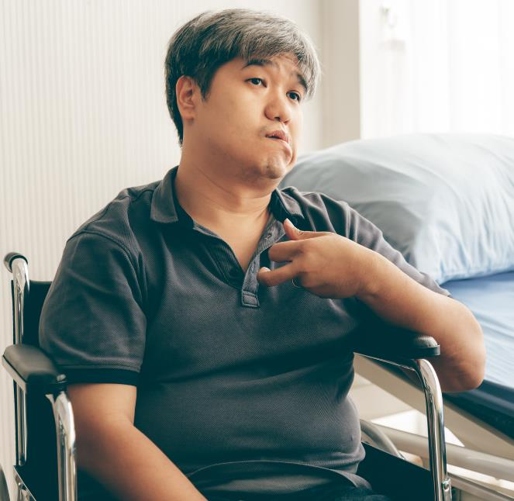
Cognitive
Environment
Memory
Modify
Attention
Adapt
Sensory
Social
Retrain
Connections
Physical
Emotional
Safe space
Strengthen
Notes:
Imagine a person who has a stroke. Physically, they might have weakness on one side of their body, making activities like bathing or dressing challenging. Cognitively, they might struggle with memory and attention, leading to difficulty planning and completing tasks. Their sensory needs may be to retrain the brain to interpret sensory signals correctly. Socially, they might feel isolated due to difficulty leaving the house, which could trigger feelings of anxiety or depression. Emotionally the OTP creates a safe space for the person to express their emotions and develop coping mechanisms for anxiety or depression.
The OTP might recommend modification to the home or adaptive equipment to improve independence

Slide 15

Notes:
We can work with individuals across the lifespan - meaning we can work with babies to individuals at the end of life.
And you don't need additional schooling or specializations to do it!

Slide 16
A doctor will help save your life.
An occupational therapy practitioner will help you live it!
Notes:
It's often said that a doctor will save your life, but an occupational therapy practitioner will help you live it!
It isn't much of a life if you can't do the things you need and want to do! Right?

Slide 17
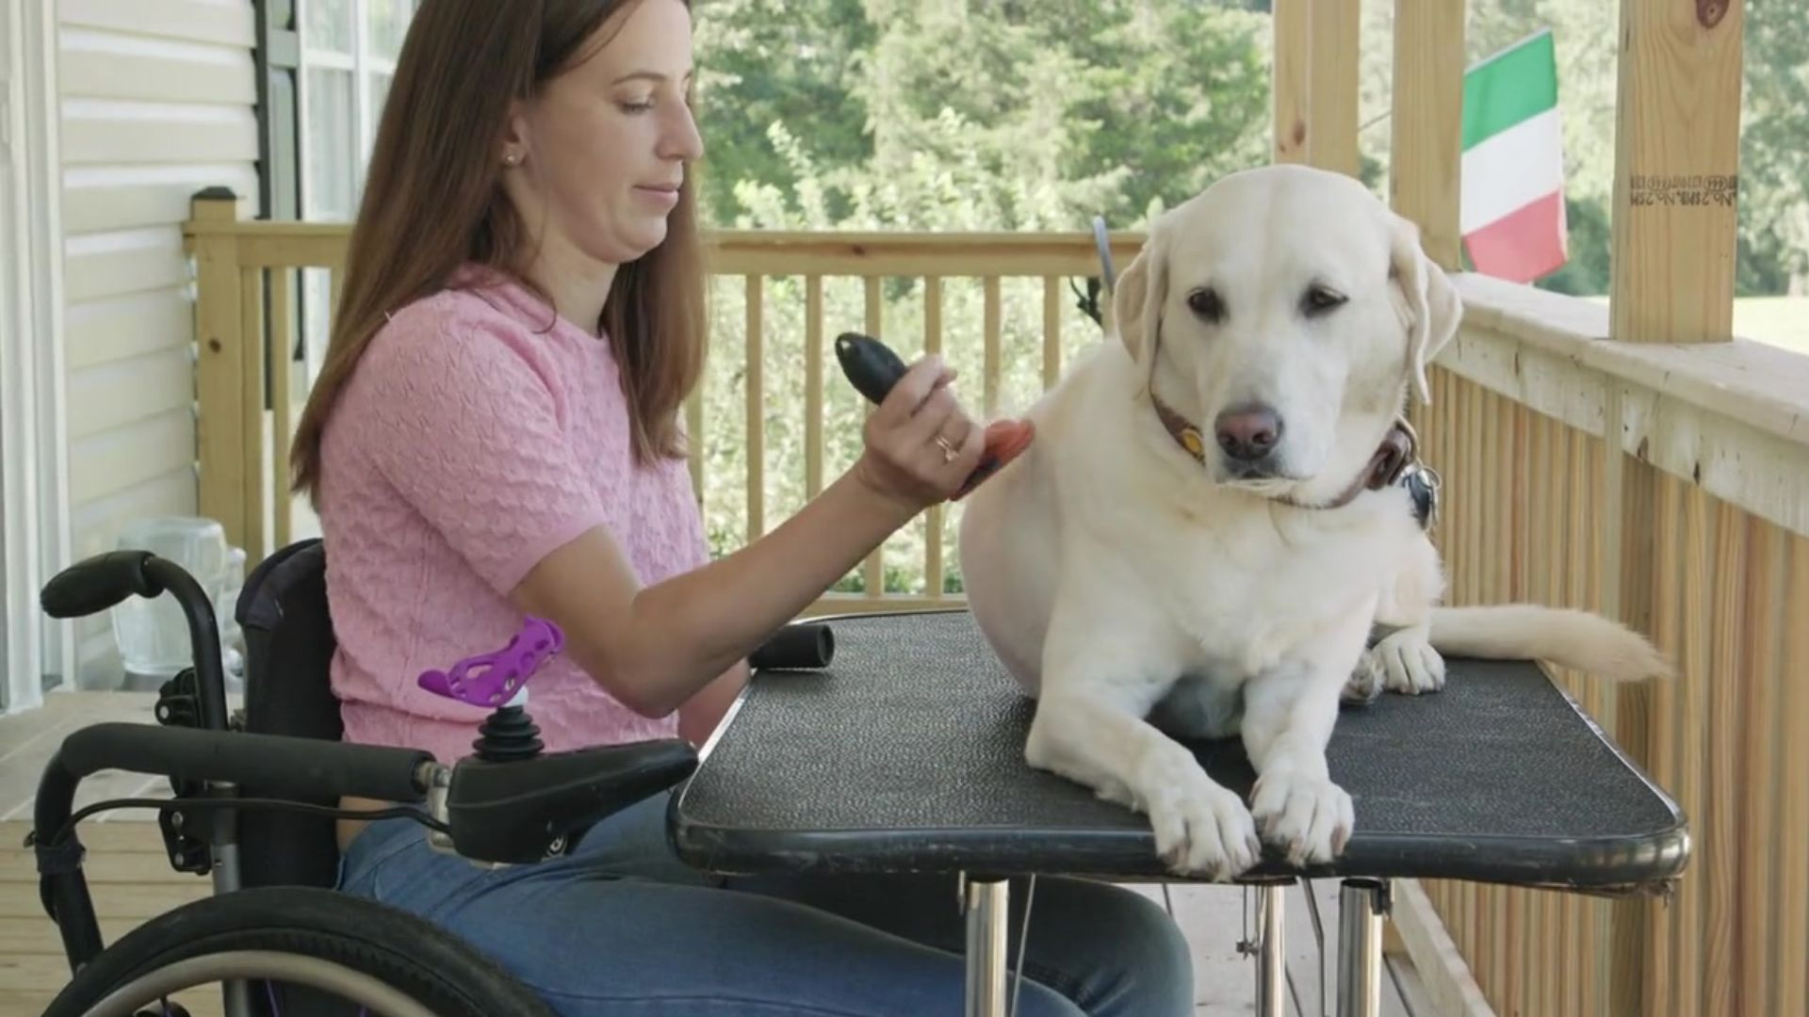
Help people live their
BEST LIVES!
Notes:
We help people participate in meaningful activities that allows them to live their best life!

Slide 18
Occupational therapy
is in many
different places.
Notes:
Occupational therapy can be found in many different places or settings.

Slide 19
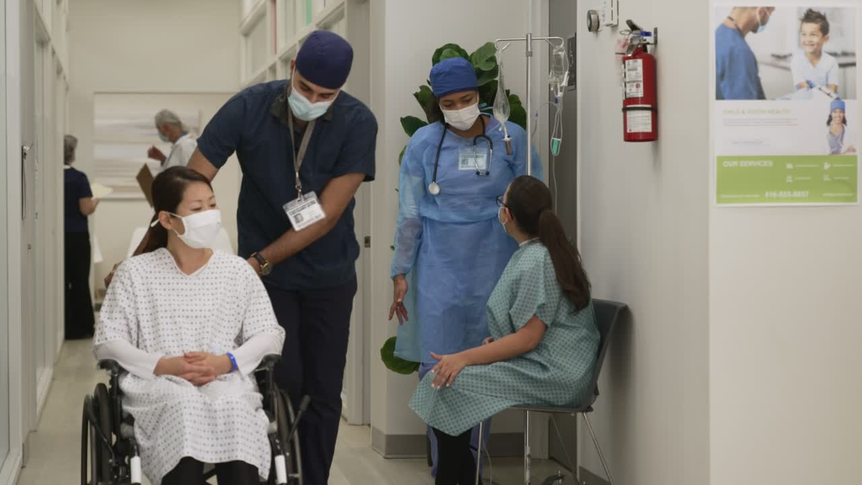
Hospitals
Notes:
We can work in hospitals. Helping people who have been sick or hurt get back to doing what they want and need to do.

Slide 20
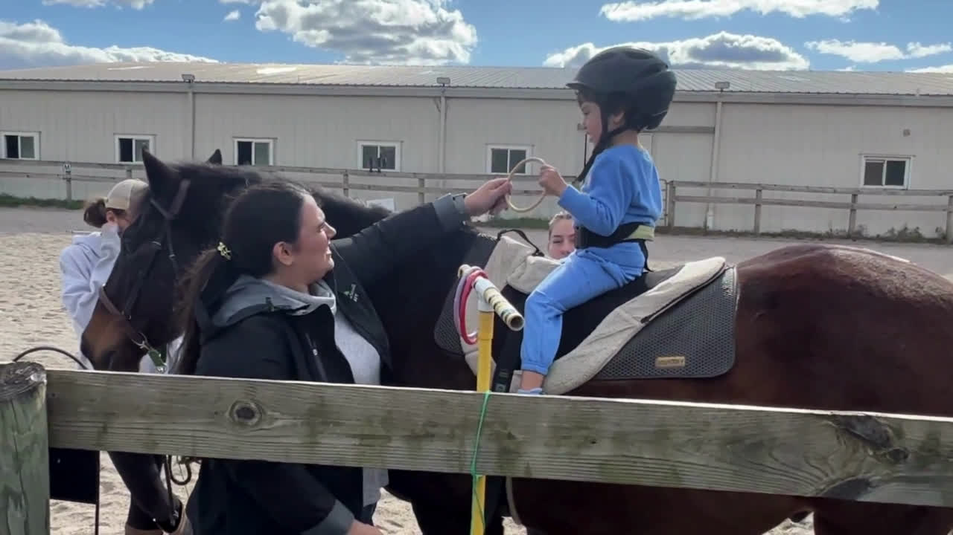
Horse Farms
Notes:
We can work on horse farms.
The horse's movements help with things like balance, strength, and coordination.
This area of practice is called hippotherapy.

Slide 21

Schools
Notes:
We can work at schools too. - making sure everyone is the best they can be!
You might have seen an OT or OTA at your school, or maybe even when you were younger

Slide 22
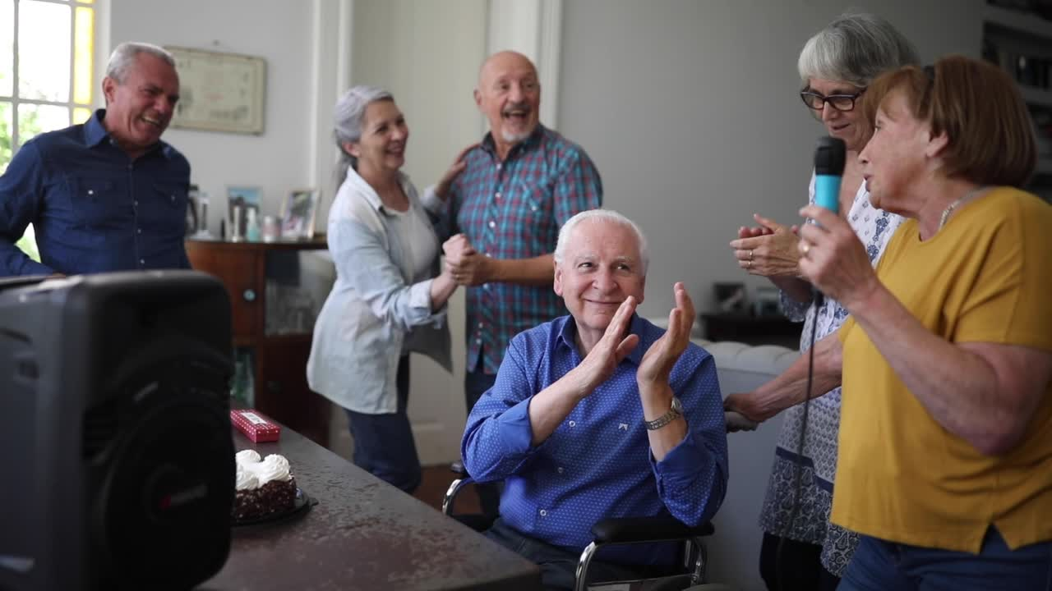
Nursing
Homes
Notes:
We can work in nursing homes. We can help older adults, or maybe even your grandparents do fun activities and stay strong so they can keep doing the things they love, like playing games and taking care of themselves.

Slide 23
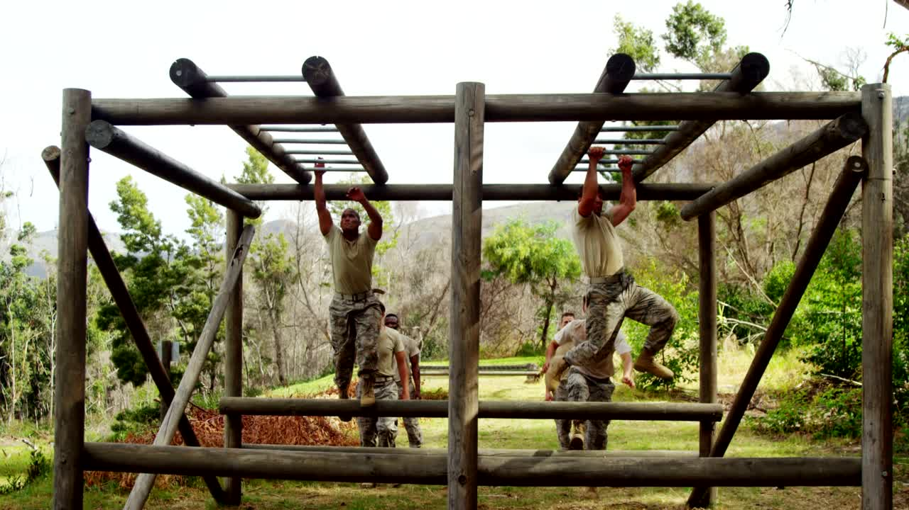
Military
Notes:
You can become an occupational therapy practitioner while being in the military. You can also work with military personnel and veterans.

Slide 24
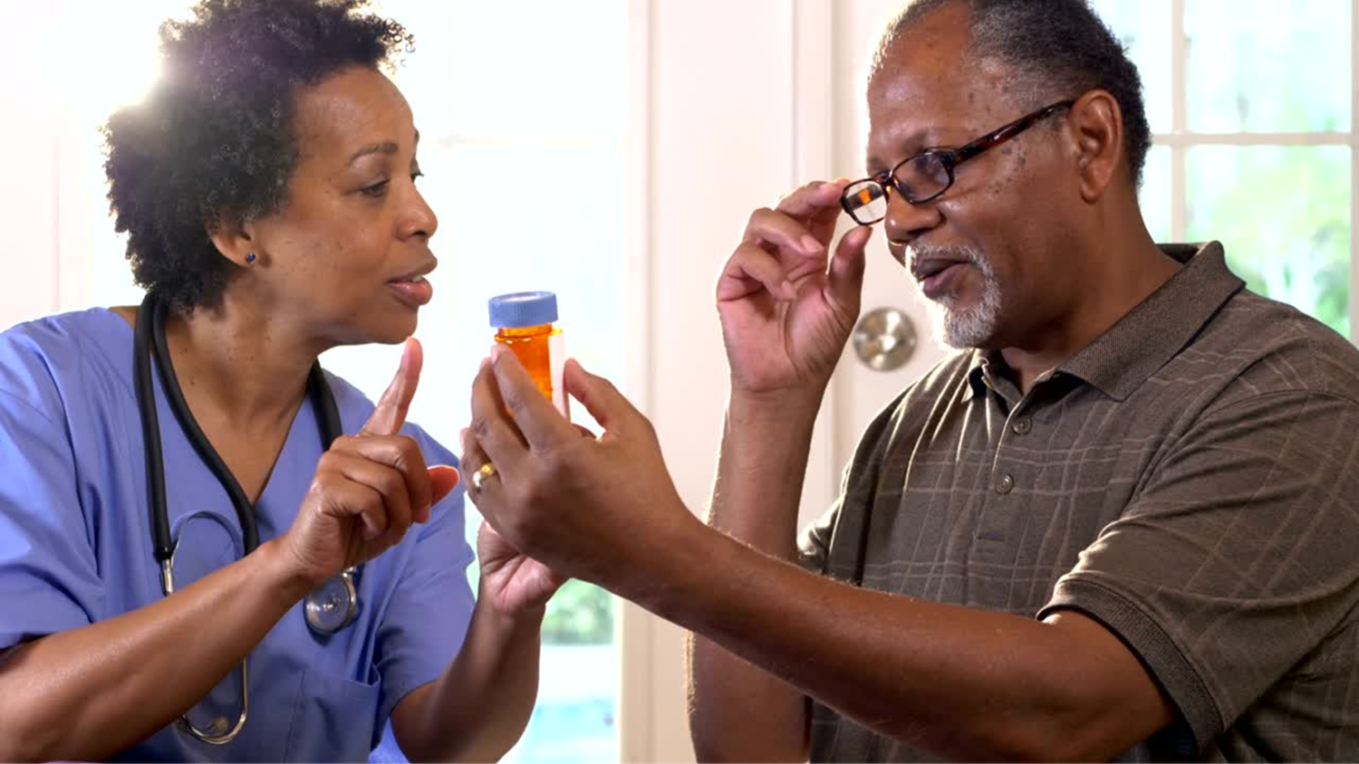
Home
Health
Notes:
We can work in nursing homes. We can help older adults, or maybe even your grandparents do fun activities and stay strong so they can keep doing the things they love, like playing games and taking care of themselves.

Slide 25
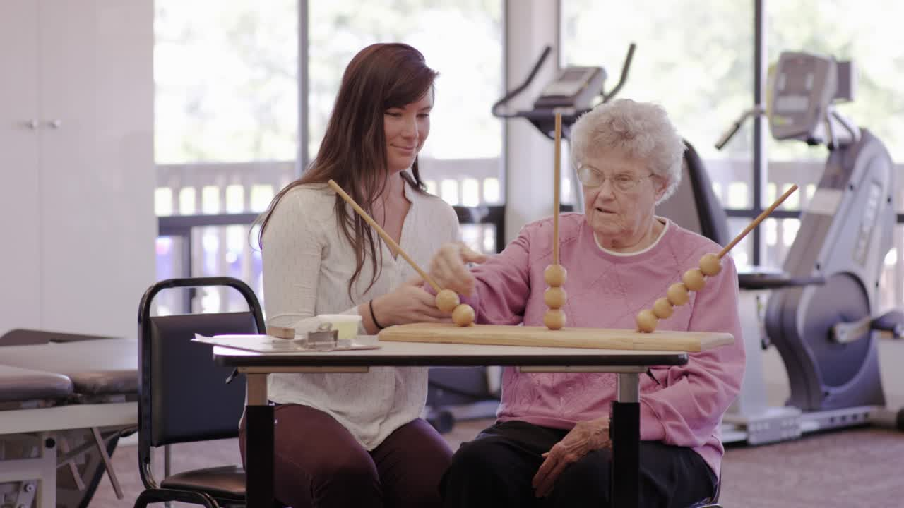
Outpatient Settings
Notes:
We can provide one-on-one, personalized care in an outpatient setting, which could be a healthcare facility or private clinic.
Helping clients to address their specific needs and goals, which might include improving physical mobility, enhancing cognitive function, or adapting to changes in daily life due to injury or illness.

Slide 26
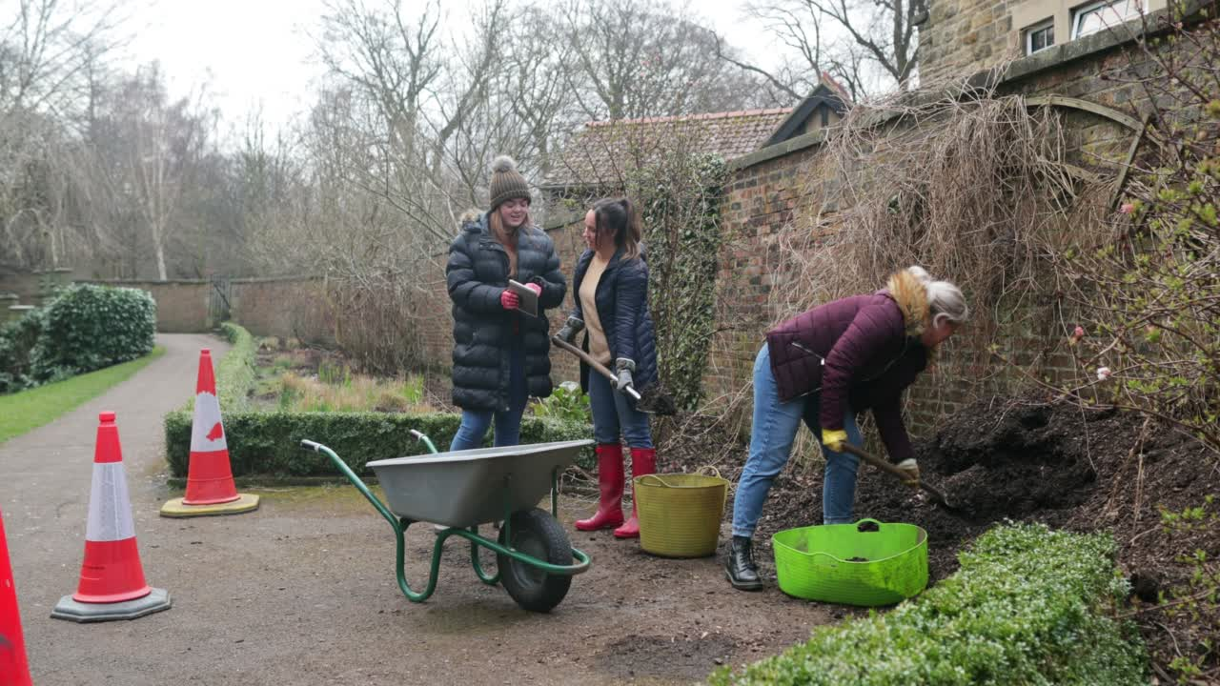
Community
Notes:
We can also work with people in community-based settings or their natural environment. This might be a community garden, vocational programs, adult or child day care, or parks.

Slide 27
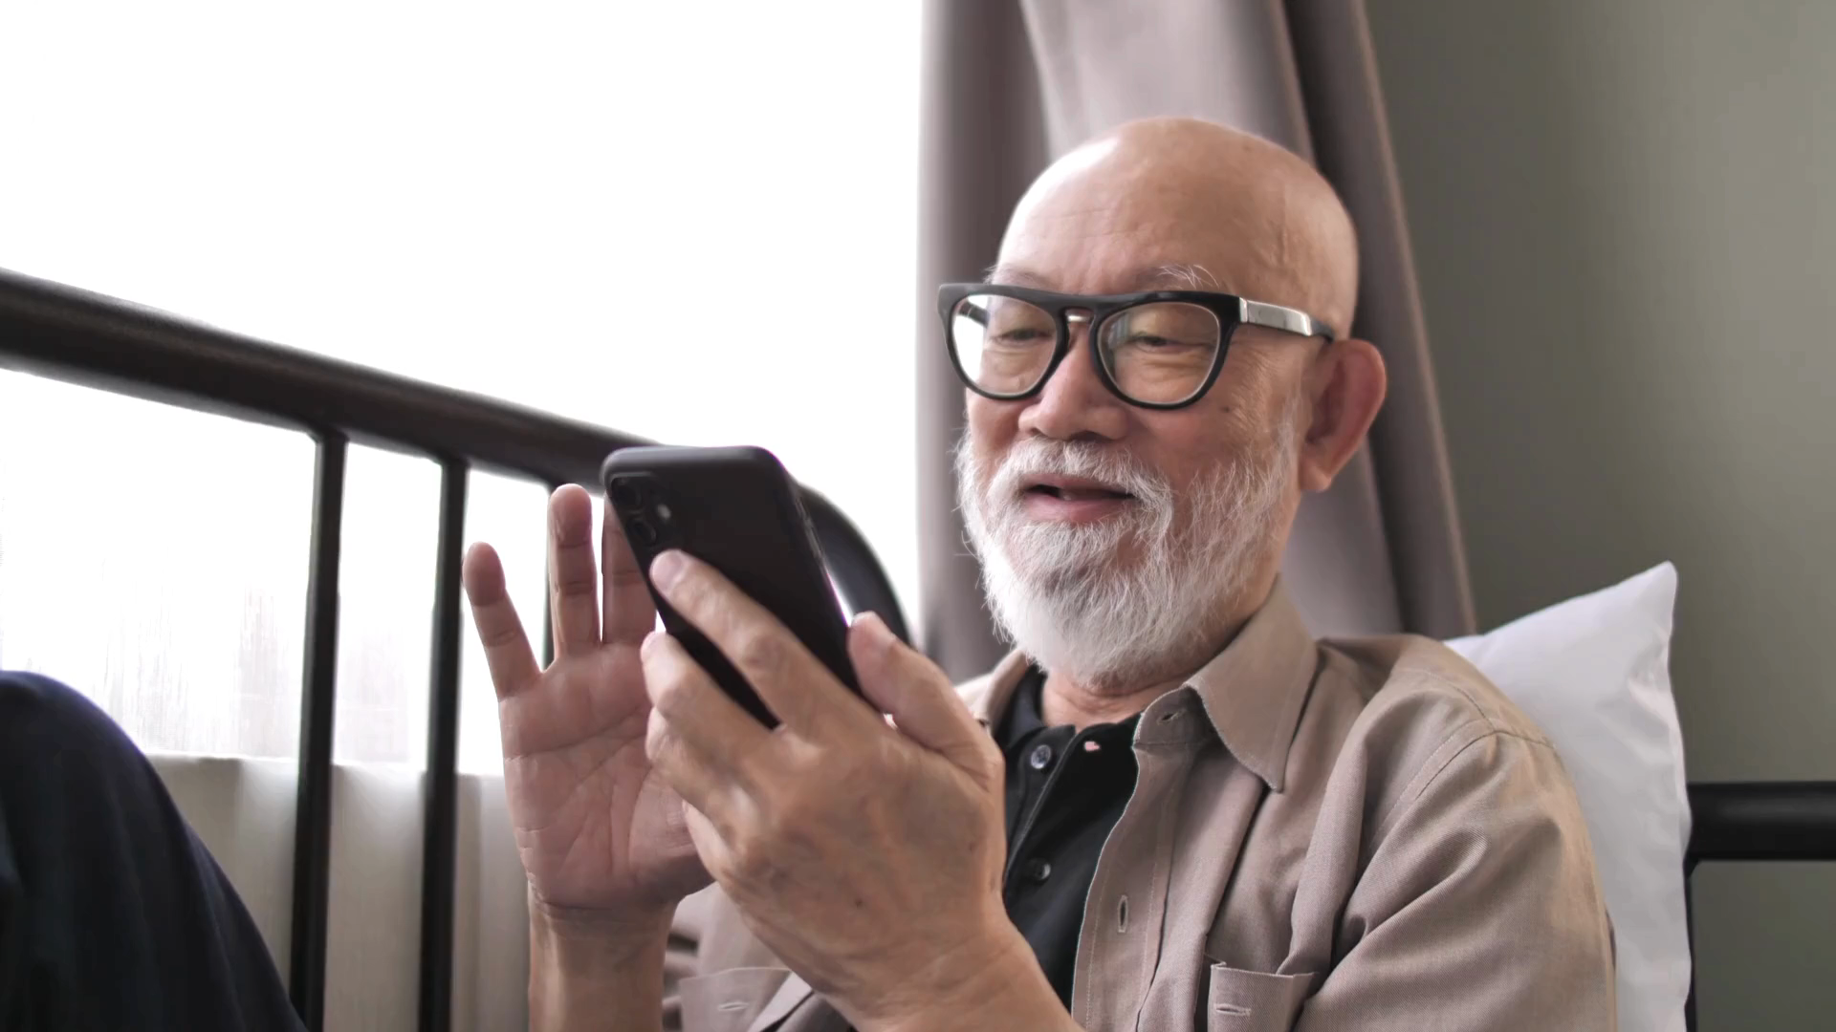
Telehealth Remote Work
Notes:
OTPs can use telehealth to provide services to people in rural areas or who have difficulty traveling. This can be a great way to reach a wider range of clients and make occupational therapy services more accessible.

Slide 28
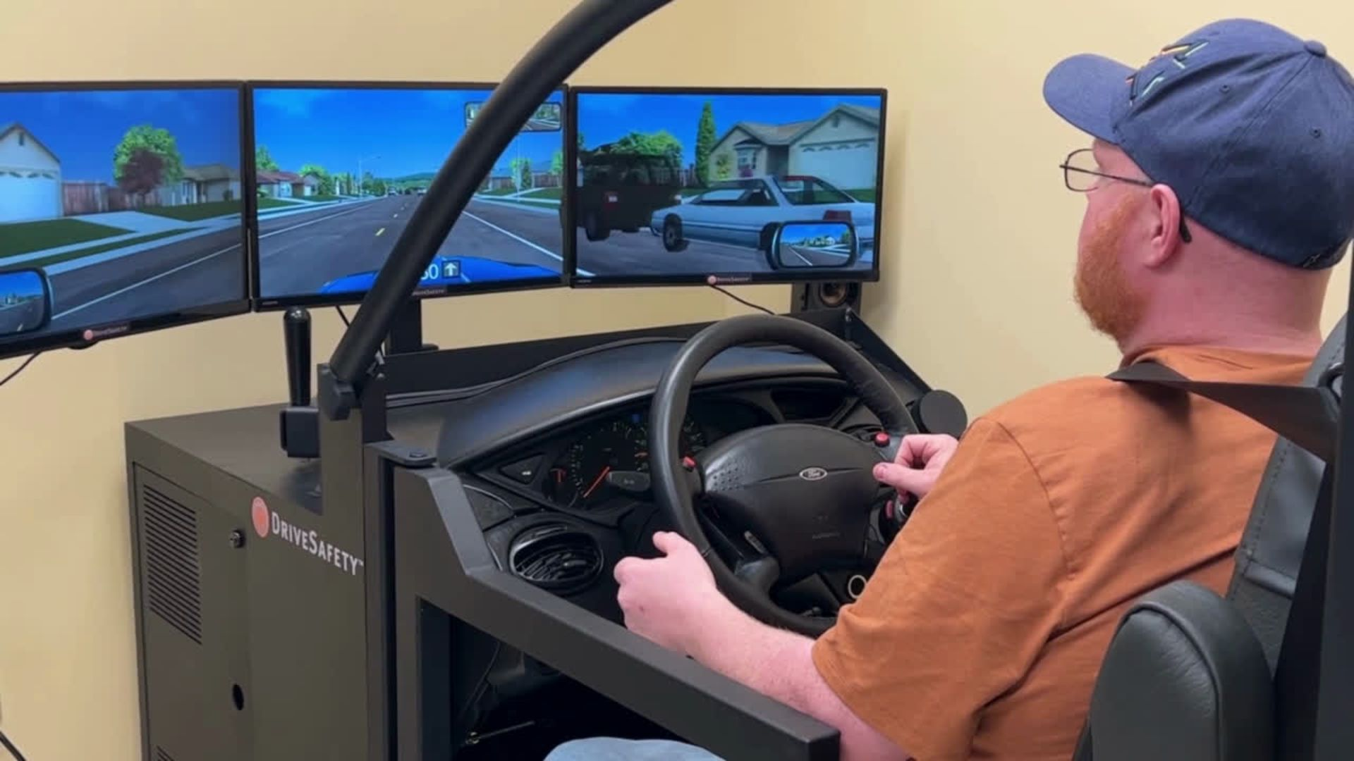
Driving Rehabilitation Centers
Notes:
Occupational therapy professionals can help people who have had a stroke, brain injury, or other medical condition to learn how to drive again. This can be a life-changing service for people who rely on driving for work or independence.

Slide 29

Travel Therapy
Notes:
OTPs can work for companies that allow them to travel around the United States while working in various settings. Contracts are typically 13 weeks at a time but can vary. Some companies may assist with state license and relocation costs.
It's a great way to see the country while getting paid to do it!

Slide 30
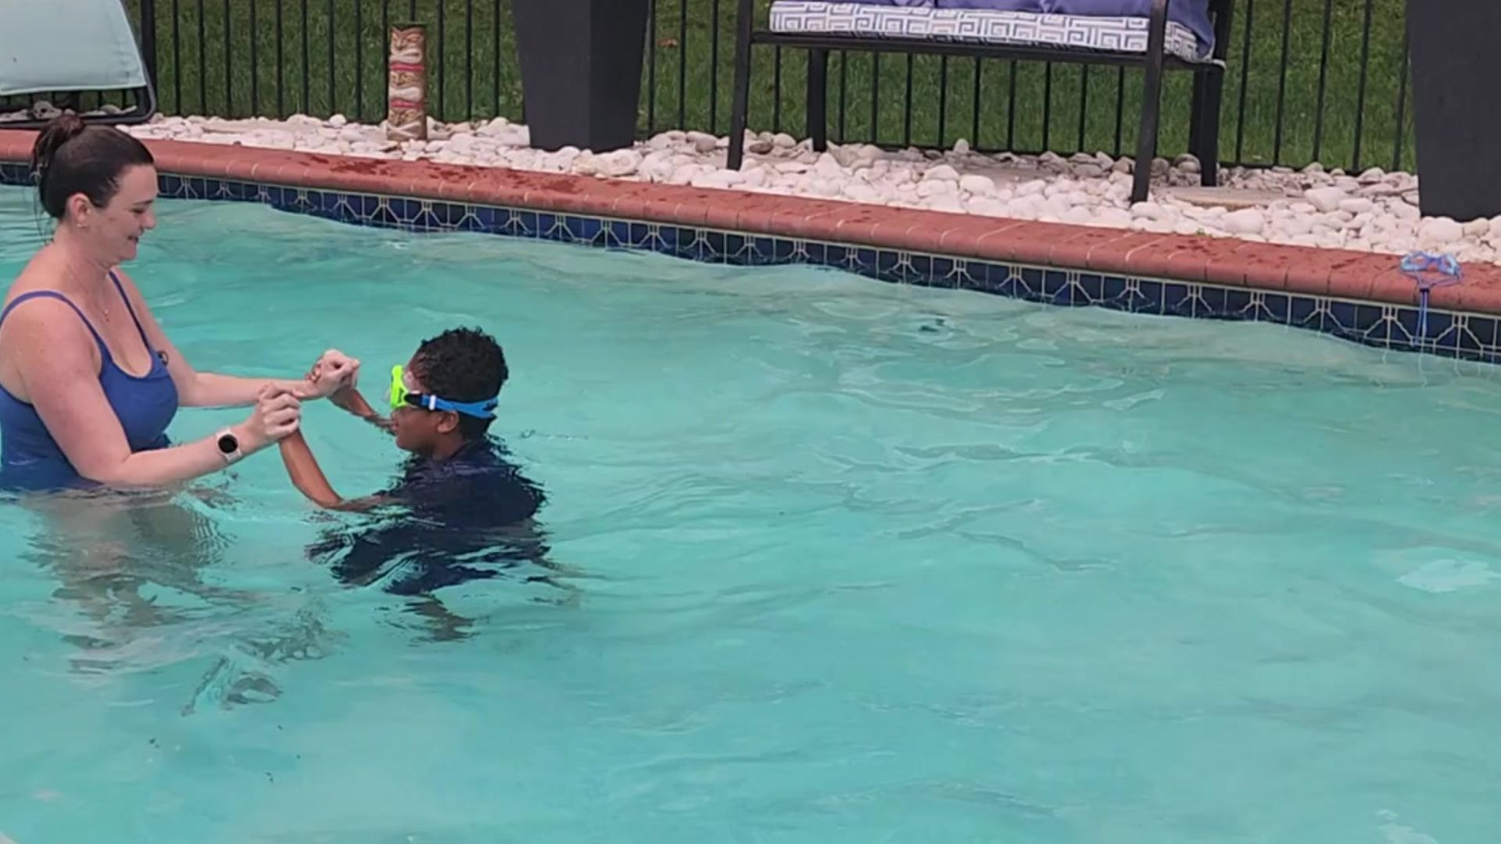
Aquatic Therapy
Notes:
Occupational therapy professionals use aquatic therapy to help children and adults improve strength, balance, and coordination in a safe environment. The water supports the body - making it easier and safer to practice everyday movements like walking and reaching, helping clients build their confidence and return to meaningful daily activities.

Slide 31
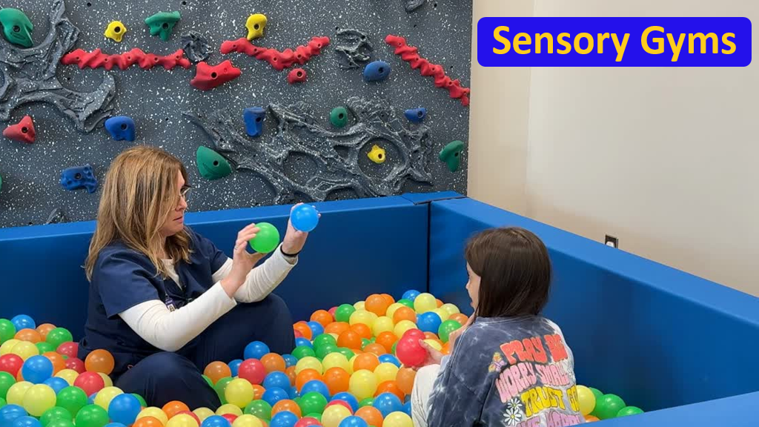
Sensory Gyms
Notes:
OTPs can work in sensory gyms to help children better process and respond to sensory input like touch, movement, sound, and sight. These spaces often include swings, ball pits, crash pads, and climbing equipment to support play, attention, and self-regulation. OTPs use sensory activities and equipment to help kids feel calmer and more focused, promoting successful participation at home, in school, and with friends.

Slide 32
Academia
Acute Care
Adult Day Programs
Animal-Assisted Therapy
Assistive Technology/Gaming
Assisted Living Facilities
Aquatic Therapy
Cardiac Rehab
Correctional Facilities
Ergonomics
Intensive Care Unit (ICU)
Mental Health
Neonatal Intensive Care (NICU)
Palliative Care
Pelvic Health
Primary Care
Rehab Clinics
Researcher
Skilled Nursing Facilities
Vision
Notes:
Here's even more settings where you can find OT practitioners
As you can see, OT is an very versatile profession!

Slide 33
Occupational Therapy
Practitioners can be:
clinical practitioners
researchers
professors
advocates
entrepreneurs
CEOs
influencers
Notes:
You can be a clinical practitioner, a researcher, a professor, an advocate an entrepreneur, a CEO, an influencer

Slide 34
And so much more!
Where there are people, there is a need for occupational therapy
Notes:
And so much more! Where they are people, there is a need for occupational therapy!

Slide 35
Qualities of an Occupational Therapy Practitioner
👍🏽
Notes:
You might be thinking, what type of person is best suited to be an occupational therapy practitioner.
Here's some qualities that are good to have when working in OT

Slide 36
People Person
Notes:
You have to like people to get into occupational therapy. That's the whole point of our job - to help people live their best lives!
We work with clients in one-on-one or small groups
You'll need
Empathy and compassion: Understanding and acknowledging the challenges clients face and showing genuine care for their well-being.

Slide 37
Creative
Problem Solver
Notes:
The ability to analyze situations, identify challenges, and develop creative solutions to help clients achieve their goals.

Slide 38
Communication
Notes:
Excellent communication skills: The ability to clearly explain diagnoses, treatment plans, and recommendations to clients and their families in an understandable way.
and
Active listening skills: Giving clients a safe space to express their needs, concerns, and goals.

Slide 39
Patience
Notes:
Patience and positive attitude: Recovery can take time, and a good OTP needs to be patient and supportive throughout the process.

Slide 40
Adaptability
Flexibility
Notes:
Adaptability and flexibility: Being able to adjust treatment plans and approaches as needed to meet the unique needs of each client - this goes back to what we talked about with holistic care - and what makes OT so unique, since we look at what matters to the client.

Slide 41
Collaboration
Notes:
Teamwork and collaboration: Working effectively with other healthcare professionals, families, and caregivers to ensure coordinated care.

Slide 42
Learner
Notes:
Lifelong learning: The field of OT is constantly evolving, and a good OTP is committed to ongoing learning and professional development.

Slide 43
Cultural
Humility
Notes:
Cultural humility: Understanding and respecting diverse cultural backgrounds and beliefs to provide culturally sensitive care.

Slide 44
There are 2 career paths in occupational therapy
OT
OTA
Notes:
There are 2 career paths in occupational therapy. You can be an occupational therapist or an occupational therapy assistant.

Slide 45
What is an Occupational Therapist (OT)?
Notes:
What's an occupational therapist or an OT for short?

Slide 46
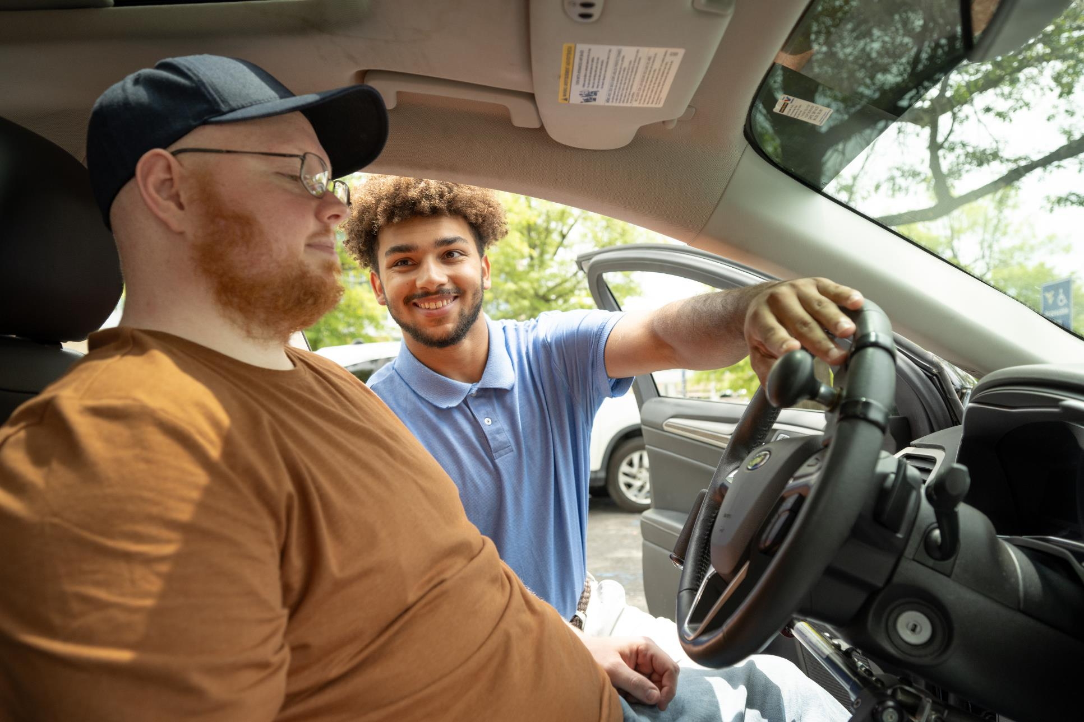
An occupational therapist (OT) will assess and design interventions to
enhance independence
Notes:
An OT assesses and designs interventions to enhance independence and overall well-being.

Slide 47
What is an Occupational
Therapy
Assistant (OTA)?
Notes:
So what's an OTA then?

Slide 48
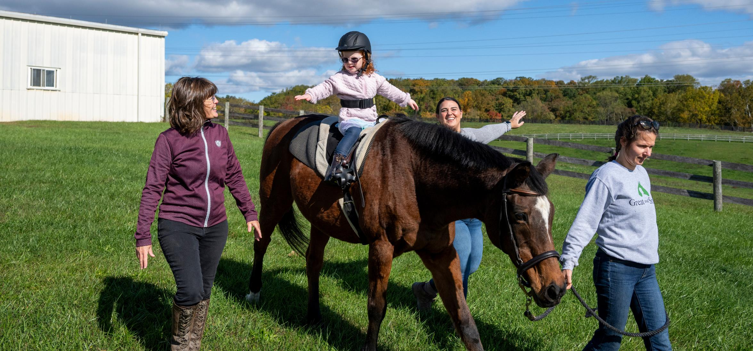
An occupational therapy assistant (OTA) works under the supervision of an occupational therapist (OT) to implement those interventions.
Notes:
An OTA works under the supervision of the OT to implement those interventions.

Slide 49
You don’t have to be a science major to be an
OT or OTA!
Notes:
You don't have to be a science major to be an OT or an OTA.

Slide 50
Pathway to Becoming an Occupational Therapist
Complete an undergrad degree.
Explore and apply to an accredited Master of Occupational Therapy (MOT) or Doctor of Occupational Therapy (OTD) program.
Graduate with a MOT or OTD degree.
Pass the national occupational therapy board exam and earn OTR® certification.
Obtain a state license to practice.
1
2
3
4
5
Notes:
You'll need to start with an undergrad degree. Then you can explore OT grad degrees. You can get either a Master's or Doctorate.
Once you graduate you will need to take and pass the national board exam which allows you to obtain a state license to practice.

Slide 51





Popular Undergraduate Majors
Kinesiology
Biology
Psychology
Exercise physiology
Chemistry
Health sciences
Education
Sociology
Therapeutic recreation
Non-traditional majors
(e.g. Art & Theater)
Notes:
You don't need an undergrad in OT - it can be in any field you want. You just need to have the prerequisites required to get into OT or OTA school.
Some people do their undergrad in health sciences, or Kinesiology, some in art, theater, music

Slide 52
Pathway to Becoming an Occupational Therapy Assistant
Explore and apply to an accredited associate or bachelor’s OTA program.
Graduate with an AA or BA OTA degree.
Pass the national occupational therapy board exam and earn COTA® certification.
Obtain a state license to practice.
1
2
3
4
Notes:
You can earn an associate's or bachelor's to become an OTA.
Once you graduate, you'll need to take and pass the national board exam for pathway as well.

Slide 53
OT Employment Expected to Grow
15%
20%
OT By 2035
OTA By 2035
Notes:
The US Bureau of labor and statistics reports that employment in OT is expected to grow by 15% for OTs and 20% for OTAs by 2035.
This is a great indicator of job stability

Slide 54
Financially Rewarding Career
$100,300
$72,300
OT Median Salary
OTA Median Salary
Notes:
Also from the US Bureau of Labor in Statistics :
In 2023, the median salary for an OT was just over 96K, and for an OTA over 68K.
it can vary a bit by location (e.g., city or state).

Slide 55
Meaningful Client Relationships
Rewarding Work
Work-Life Balance
Constantly Evolving Field
Diverse Settings
Every Day is Different
Notes:
Working in occupational therapy provides:
meaningful client relationships, which results in rewarding work.
You get a great work-life balance, by choosing where and how you want to work.
The field is constantly evolving and you get to work in so many different settings.
Everyday is different and allows you the opportunity to make a positive impact on someone's life.

Slide 56
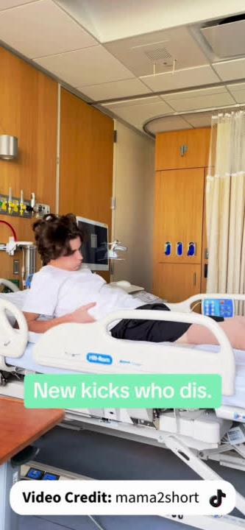
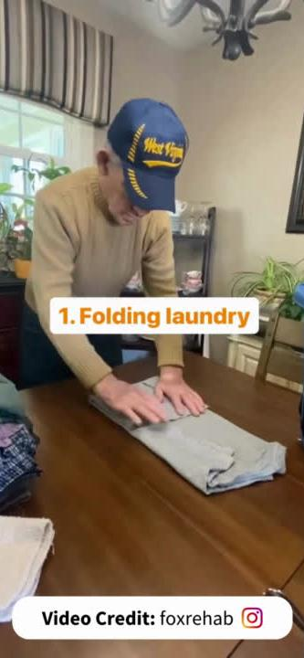
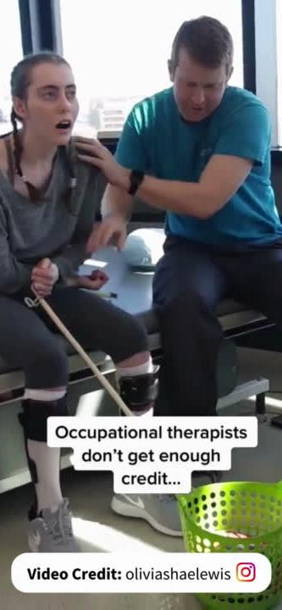
Change Lives
Notes:
Here's just a few examples of OT.
Helping a teenager reclaim his independence after a spinal cord injury
Helping individuals with dementia live as independently as possible.
Helping someone who has suffered a traumatic brain injury learn how to do everything again.

Slide 57
Make a difference in someone’s life everyday!
🤗

Slide 58
How Can You Prepare Now?
Shadow an OT or OTA
Research Schools
Find a mentor
Notes:
So if you are interested, how can you prepare for a future in occupational therapy now?
Shadow an OT or OTA. Volunteer in settings where occupational therapy happens so you can witness it and be a part of it.
Research schools - start looking to see where you might like to go and what prereqs are required.
Find a mentor - there are many OTPs who would love to help you discover this amazing career.

Slide 59
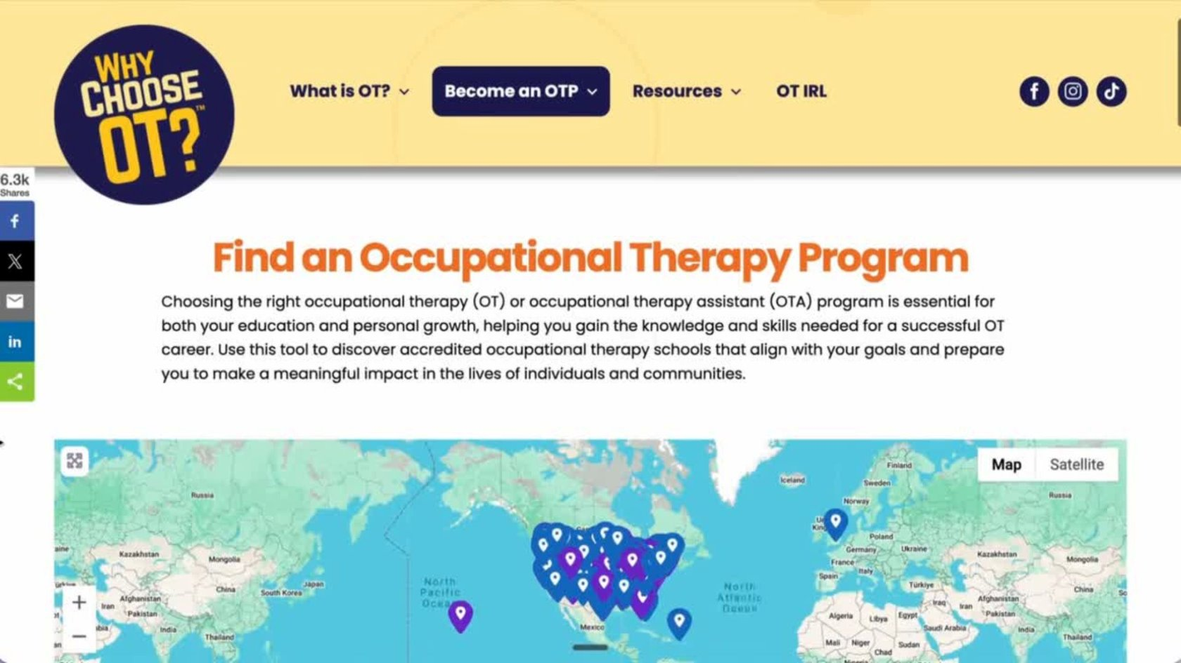

Slide 60
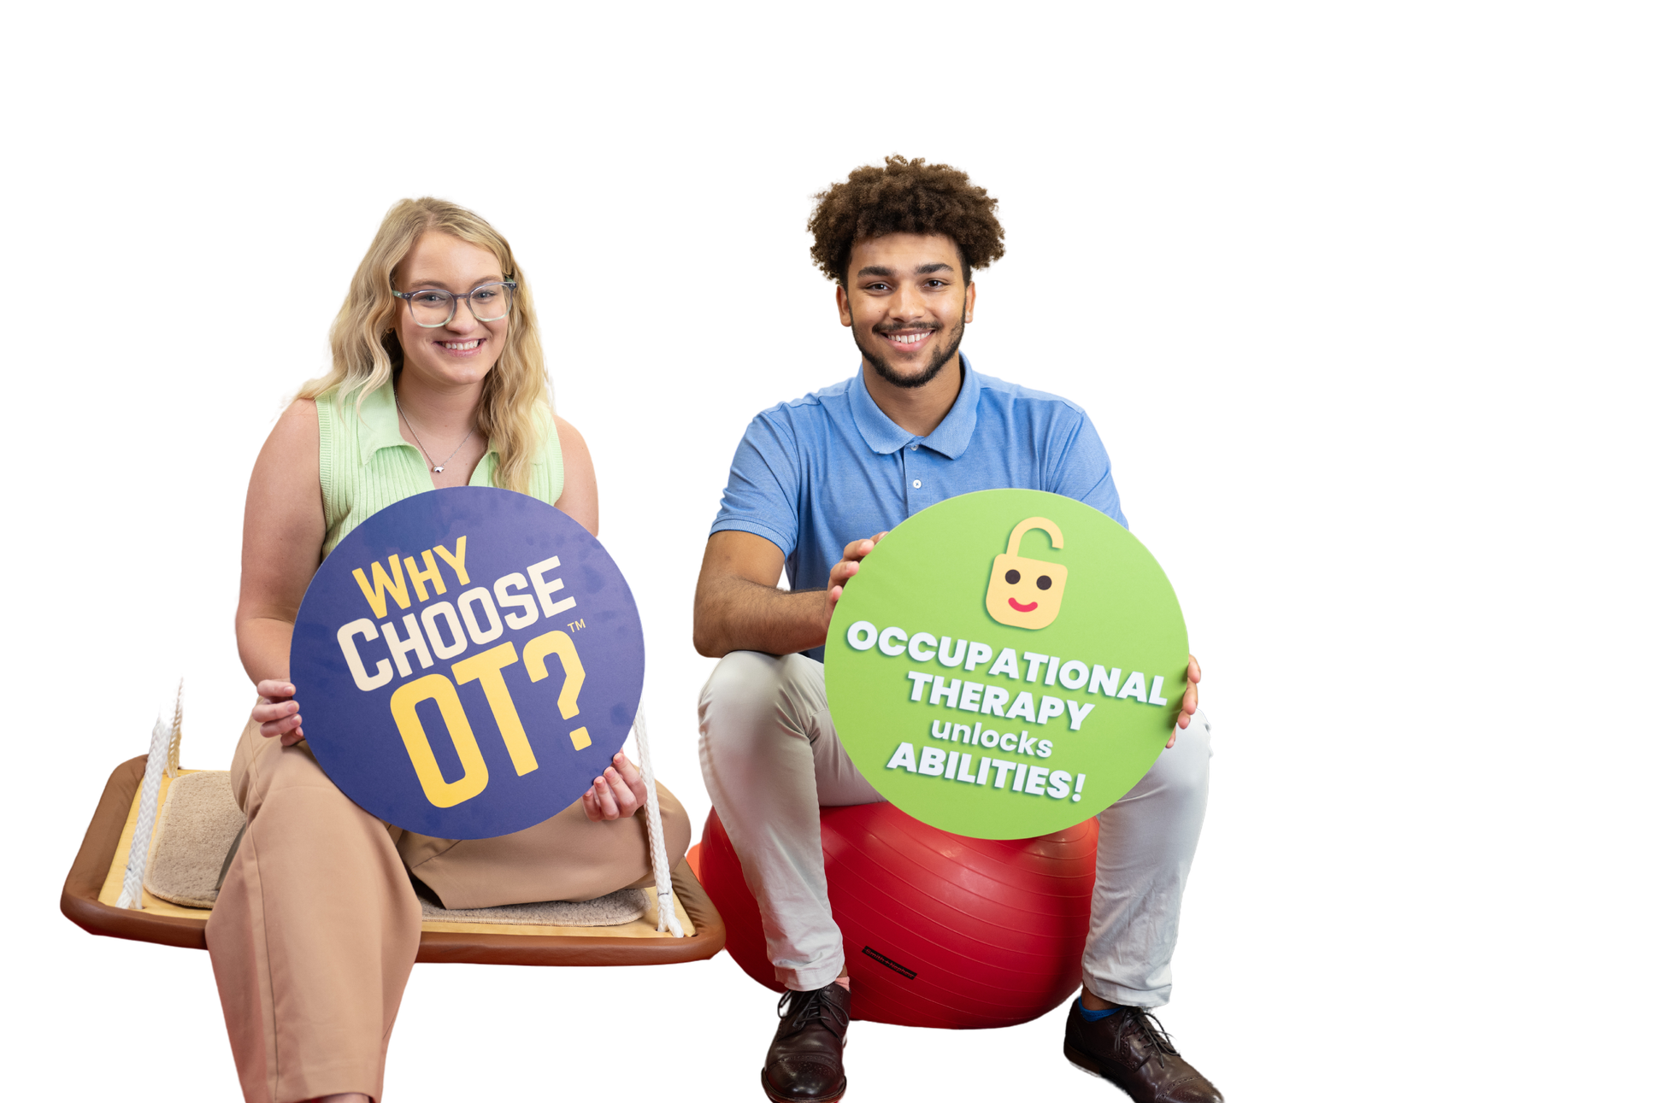
Stay Connected
@WhyChooseOT
Notes:
Stay connected. Learn more about occupational therapy by following WhyChooseOT on TikTok and Instagram.

Slide 61

WhyChooseOT.com
Notes:
You can find the info we talked about today and more at whychooseot.com
Does anyone have any questions about what we talked about?
Thank you for letting me spend time with you today.

