Slide 1

OT = Occupational Therapy
Notes:
Introduce yourself
I'm here today to talk to you about a career called occupational therapy.
If you've heard of occupational therapy before, raise your hand.
That's great, I hope by the end of our time together today you all have a better idea of what occupational therapy is and how cool of a job it is!

Slide 2
Let’s talk about
some things you and
your family need
and want to do everyday!
Notes:
Let's talk about some things you and your family need and want to do every day.

Slide 3

Notes:
You all want to play! You might play with friends or family.
You may play a sport, or at the park, or at home.
You play every day!

Slide 4

Notes:
Your parents or older family members drive or maybe take the bus.
They need to do that to get to work, to take you to sports, to see family, to go to the doctor.
You are probably in a car or maybe a bus almost every day!

Slide 5

Notes:
School is helping you become the best version of YOU, ready to tackle any challenge life throws your way!

Slide 6

Notes:
Your family cooks meals or goes out to eat.

Slide 7

Notes:
Maybe you play video games with your siblings or your friends.

Slide 8

Notes:
Your family grocery shops. Think about the times you've been to the grocery store before, it's a pretty big place.

Slide 9

Notes:
Maybe your family likes to hike or do things together outdoors.

Slide 10
What are
some of your
favorite things
to do?
Notes:
What are some of your favorite things to do?
(call on a few kids)

Slide 11
What if you could not do those things?
Notes:
How would you feel if you or your family and friends couldn't do those things anymore?
Maybe they can't do them because they had an accident, or maybe they have trouble doing things that were once easy to do because they had a bad fall or an illness.
Or maybe you know someone who might need extra help with things.

Slide 12
Occupational Therapy helps people
do the things they need
and want to do!
Notes:
Occupational therapy - what I do - helps people do the things they need and want to do.

Slide 13

Help someone
get back
to surfing
Notes:
We can help someone get back to surfing after they got hurt

Slide 14

Help someone
with handwriting
Notes:
We can help people with handwriting - to learn how to grasp a pencil properly, to form and space out letters
We could use grips or special pencils.

Slide 15

Help someone
using a wheelchair live their life
Notes:
We can help people using a wheelchair by helping them learn how to get in and out of it safely.
We also help them pick and customize their wheelchair; to ensure comfort, safety, and optimal mobility.
How to make their home more accessible for their wheelchair.
How to dress, bathe, and get ready for their day.
We can help with power wheelchairs, special controls for people who can't use their hands, and voice tools for people who can't speak.

Slide 16
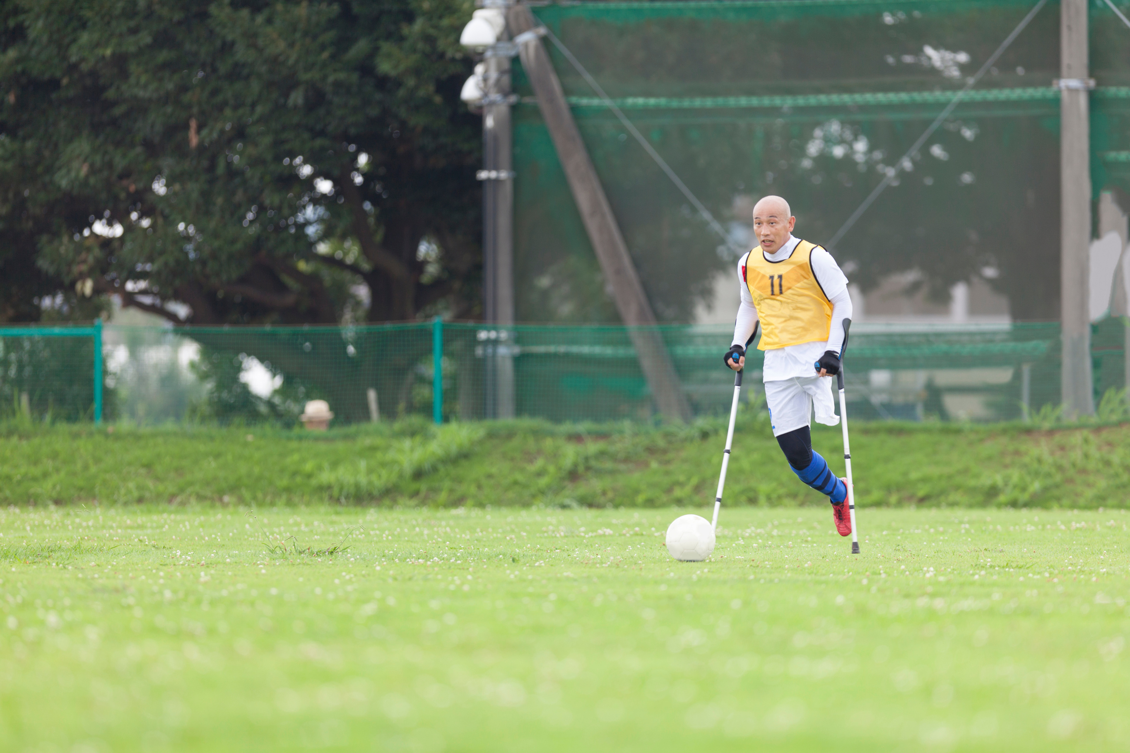
Help someone
play
Notes:
We can help kids and adults play. Play is so important as you grow up!
We help play fun games that make your body and mind strong.

Slide 17

Help someone
play
Notes:
We help everyone so they can participate in play!

Slide 18
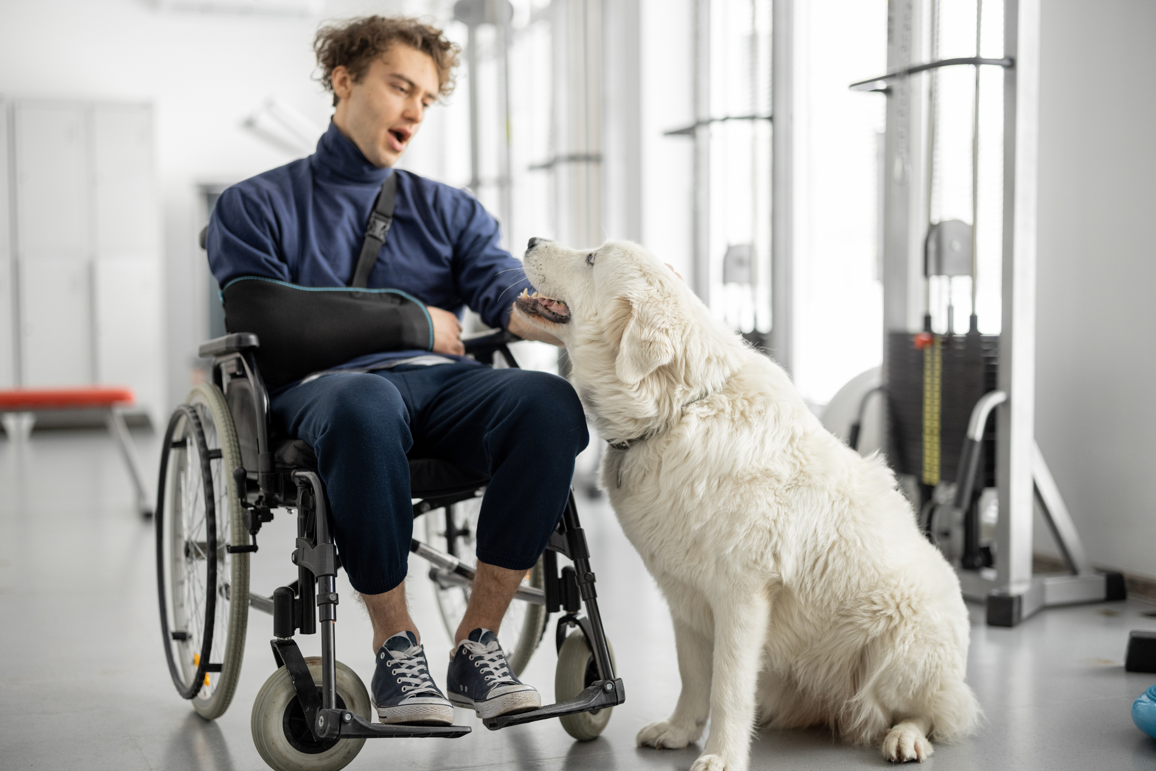
Help people live their
BEST LIVES!
Notes:
We are healthcare superheroes who help people live their best lives by making everything super fun and awesome!

Slide 19
Occupational therapists
or therapy assistants
can work in many
different places!
Notes:
Occupational therapists and therapy assistants can work in many different places. Here are just a few examples.

Slide 20
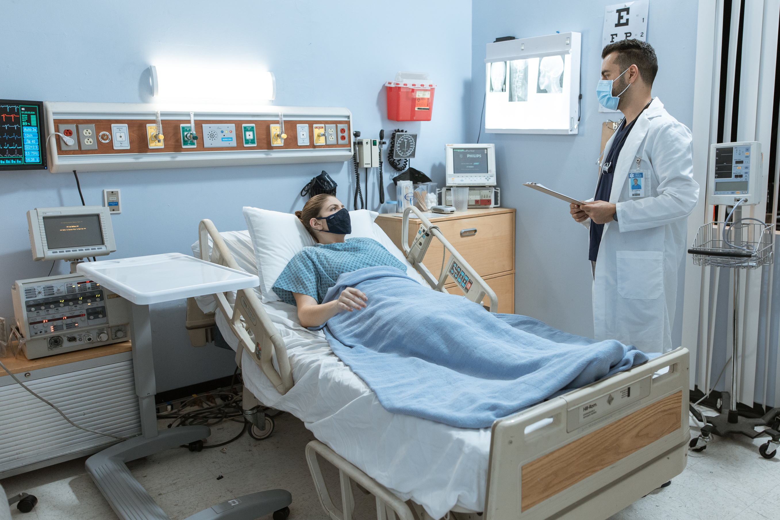
Hospitals
Notes:
We can work in hospitals. Helping people who have been sick or hurt get back to doing what they need to do.

Slide 21
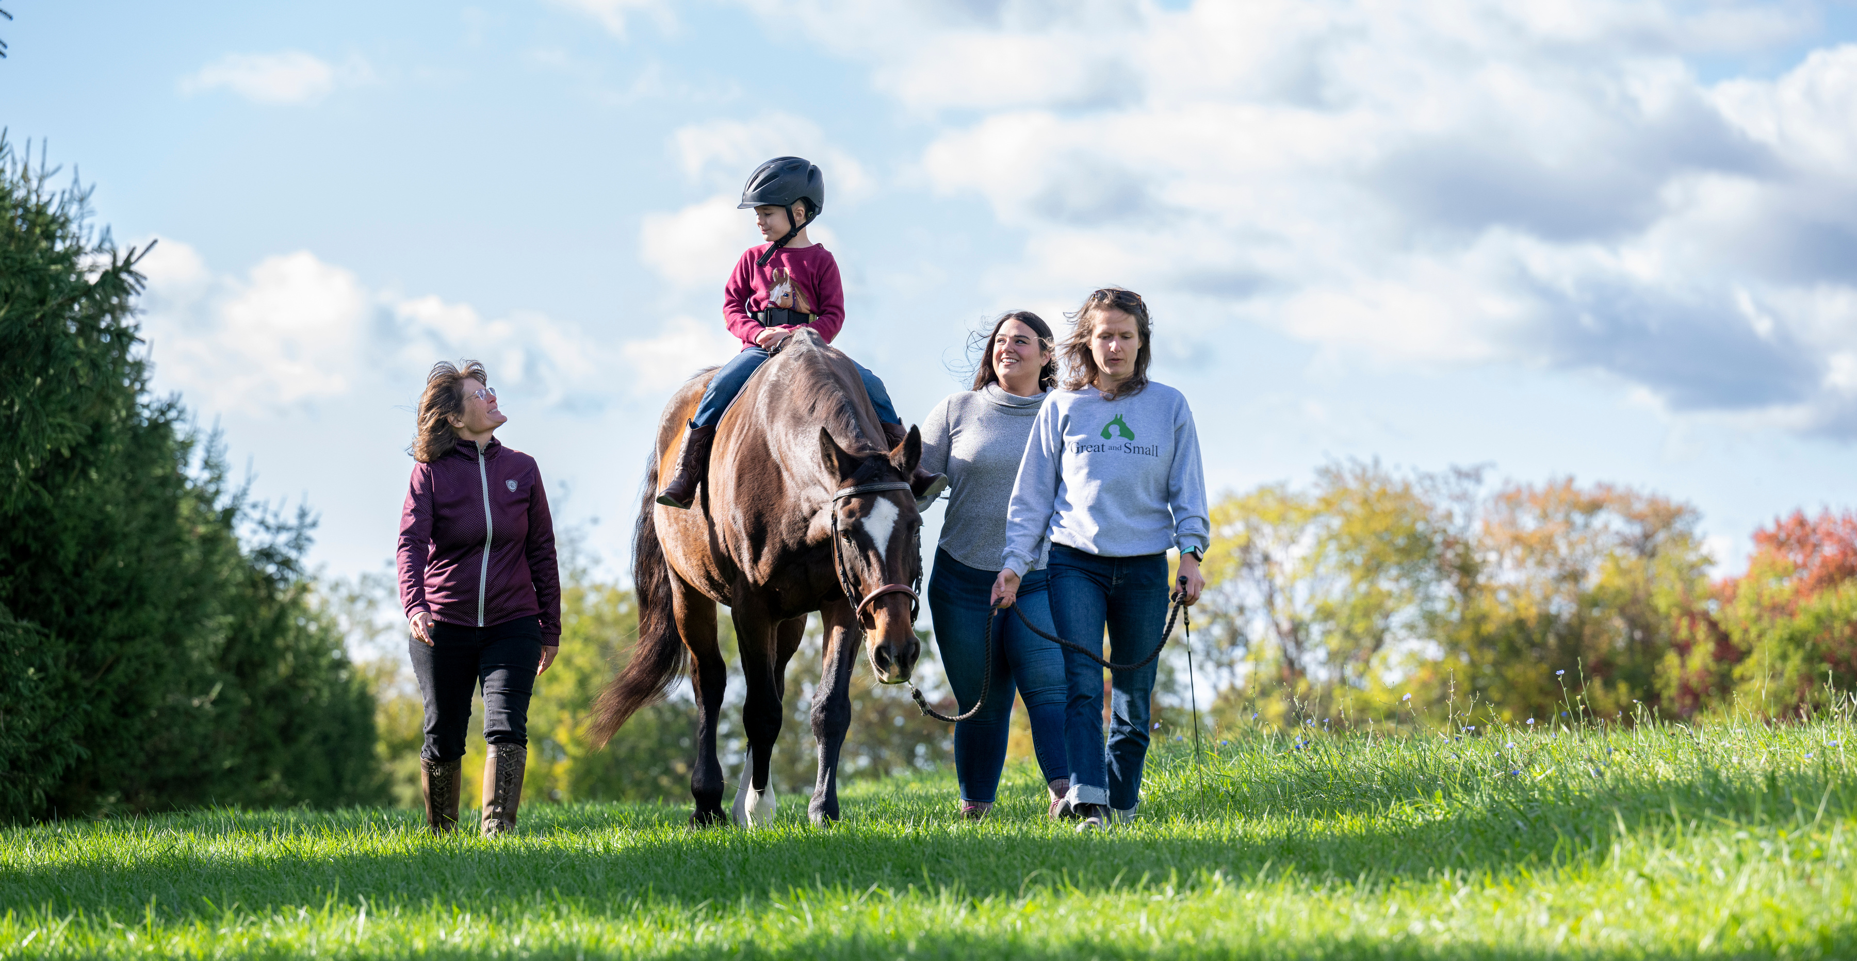
Horse Farms
Notes:
We can work on horse farms.
People ride the horse, and the cool part is that the horse's movements help with things like balance, strength, and coordination.

Slide 22

Schools
Notes:
We can work at schools too. Think of OTs as your school superheroes, making sure everyone is the best they can be!
Do you know if your school has an OT or OTA?

Slide 23
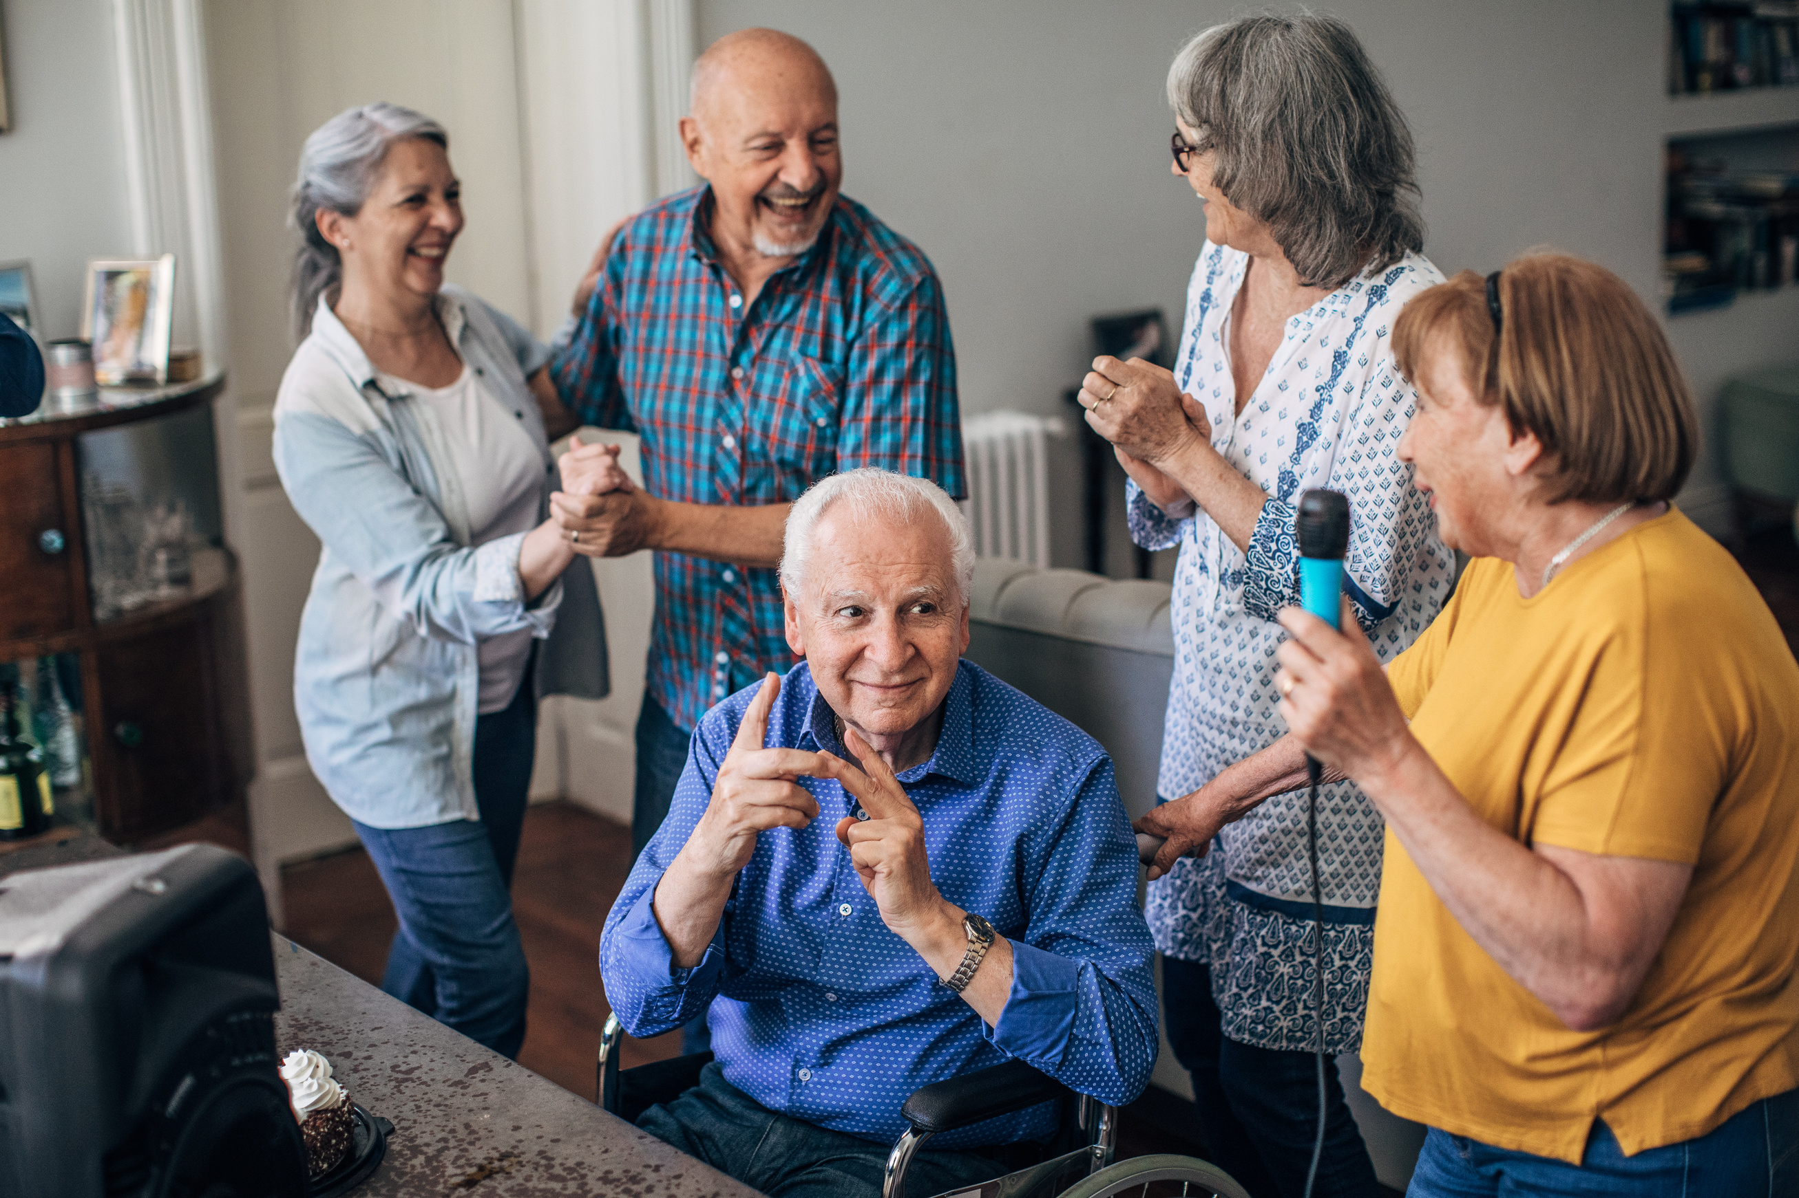
Nursing
Homes
Notes:
We can work in nursing homes. We can help older adults, or maybe even your grandparents do fun activities and stay strong so they can keep doing the things they love, like playing games and taking care of themselves.

Slide 24

Notes:
We can work with individuals across the lifespan - meaning we can work with babies to individuals at the end of life.

Slide 25
A doctor will help save your life.
An occupational therapy practitioner will help you live it!
Notes:
It's often said that a doctor will save your life, but an occupational therapy practitioner will help you live it!
It isn't much of a life if you can't do the things you need and want to do! Right?

Slide 26
They get to work
with cool gear!
Notes:
We get to work with some pretty cool gear.

Slide 27

Notes:
We can work with swings, mats, rock walls, ball pits, balance beams, and so much more!

Slide 28
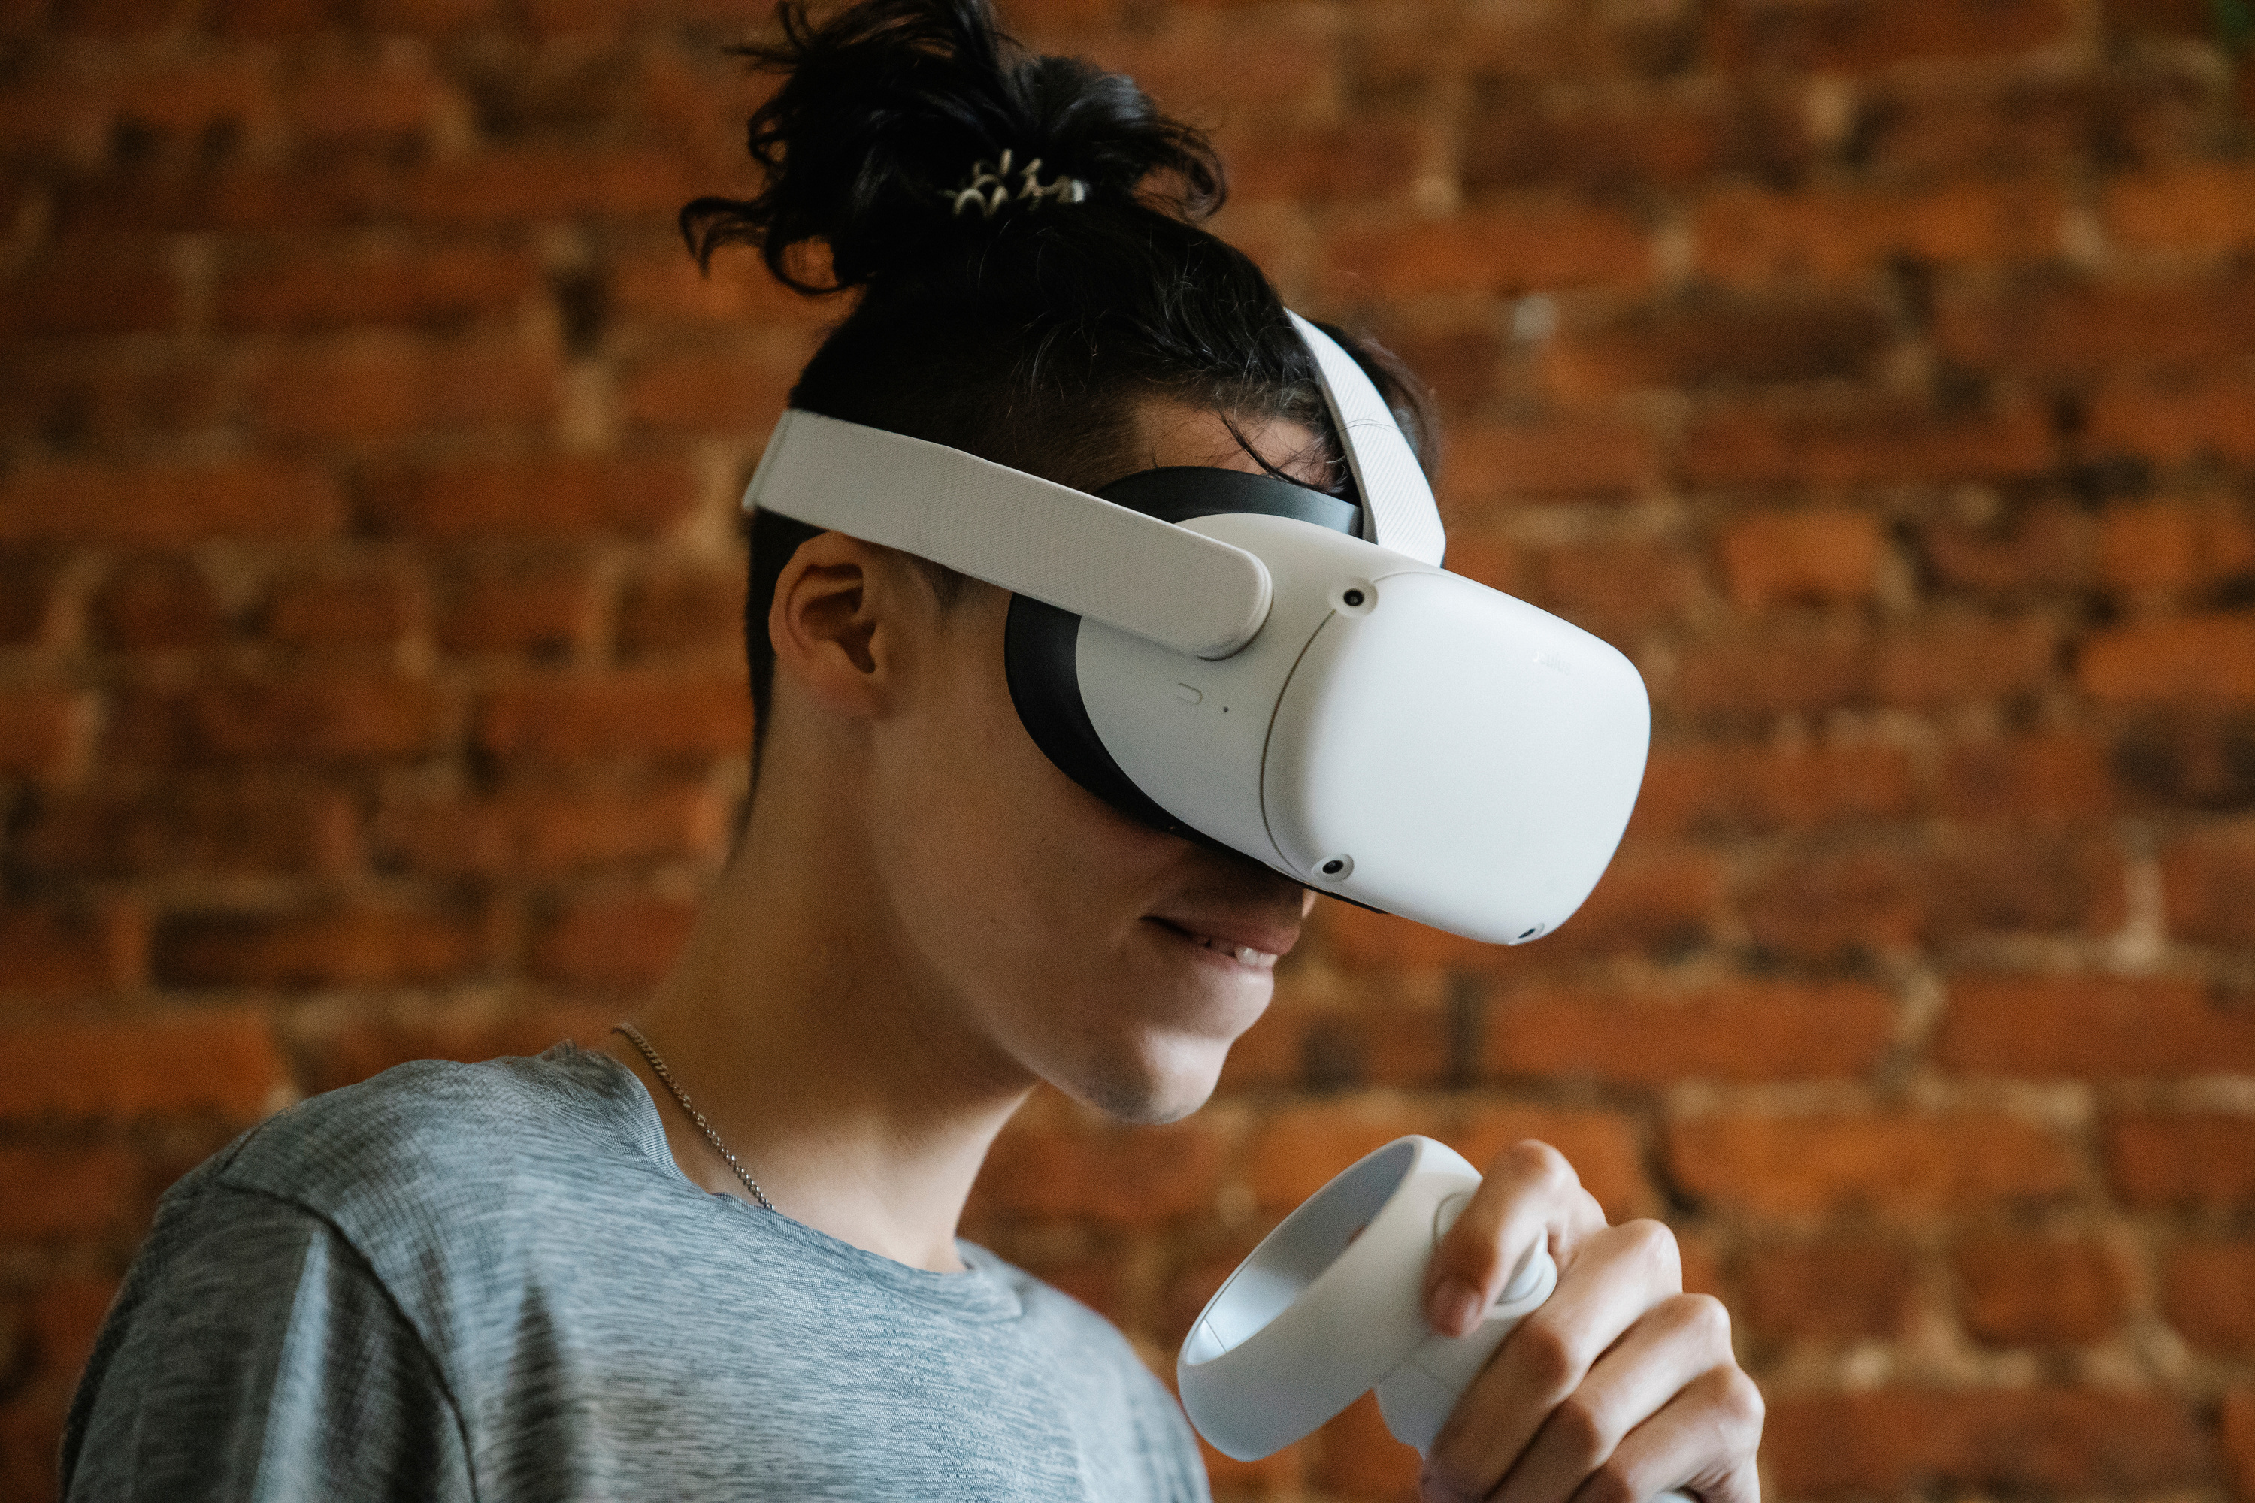
Notes:
We can use virtual reality to create amazing games that help kids and grown-ups practice important skills like moving, playing, and getting stronger in a pretend world

Slide 29
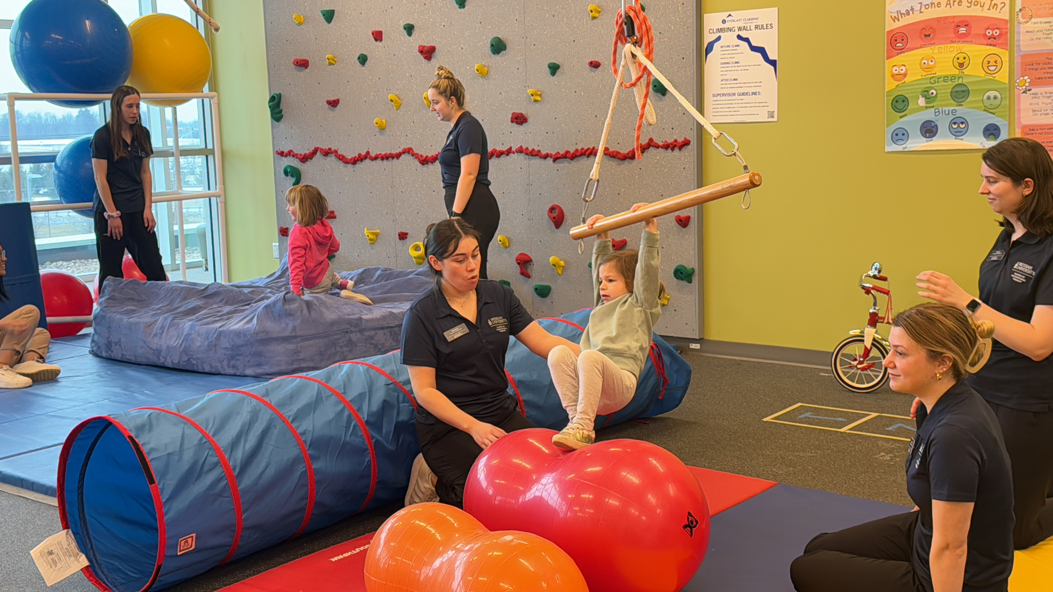
Notes:
If we work with kids, we get to play with them all day! We use all types of different equipment and toys to make therapy fun and engaging.

Slide 30
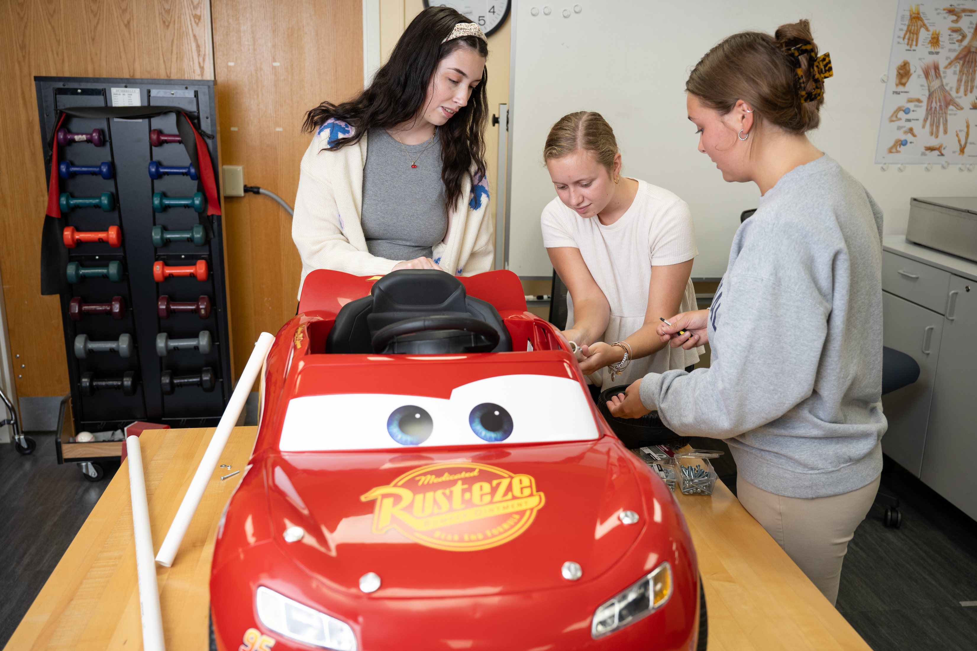
Notes:
We use different items to change toys for kids. This car will help a child who can't sit up by themselves or steer the car.

Slide 31
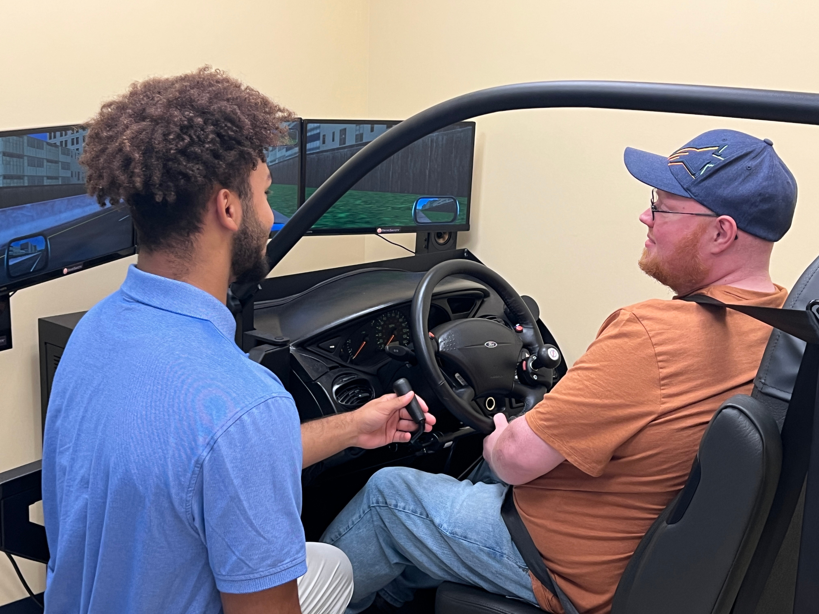
Notes:
We can use a device, almost like a driving game you would see at an arcade, that helps people pretend or practice driving, which lets us check if it’s safe for people to get back to driving.”

Slide 32
Pretty cool, right?
Notes:
My job sounds pretty cool, right?
I can work in so many different places and with so many different people.
We work wherever there are people. So everyone can live their best life!

Slide 33
One day YOU
could work in
Occupational Therapy!
Notes:
One day you could work in occupational therapy.

Slide 34

Learn More
@WhyChooseOT
Notes:
Learn more about occupational therapy and see OT in action by following WhyChooseOT on TikTok and Instagram.

Slide 35
WhyChooseOT.com
Notes:
I hope as you move up through school and think about what you want to be that you remember this presentation and choose OT!
Thank you so much for letting me talk to you today.

